Slide 1
MGS 425 (S1S) Management of it projects
Week 2 – February 8th

Slide 2
Agenda
TopHat Assignment will be given based on material from this week.
Due by end-of-day (11:59 pm) on Sunday, February 14th
Chapter 2 – Scrum Framework
Chapter 3 – Agile Principles
Chapter 4 – Sprints

Slide 3
Scrum framework
Chapter 2

Slide 4
Scrum Framework
Overview
Scrum is not a prescriptive process that follows a sequential steps in a fixed amount of time with a fixed budget.
Scrum is a framework for organizing and managing work.
It is based on a set of values, principles, and practices that provide the foundation for a unique approach that is tailored to the organization.
To better grasp the framework concept, imagine that the Scrum framework is like the foundation and walls of a building.
The Scrum values, principles, and practices would be the key structural components.

Slide 5
Scrum Framework
Overview
Values, principles, or practices within the framework cannot be altered or changed without risking collapse.
However, the inside structure of Scrum can be customized by adding fixtures and features until the process is a good fit for the organization.
Scrum is a refreshingly simple, people-centric framework based on the values of honesty, openness, courage, respect, focus, trust, empowerment, and collaboration.

Slide 6
Scrum Framework
Overview
Notes:
The Scrum practices themselves are embodied in specific roles, activities, artifacts, and their associated rules (see Figure 2.1).

Slide 7
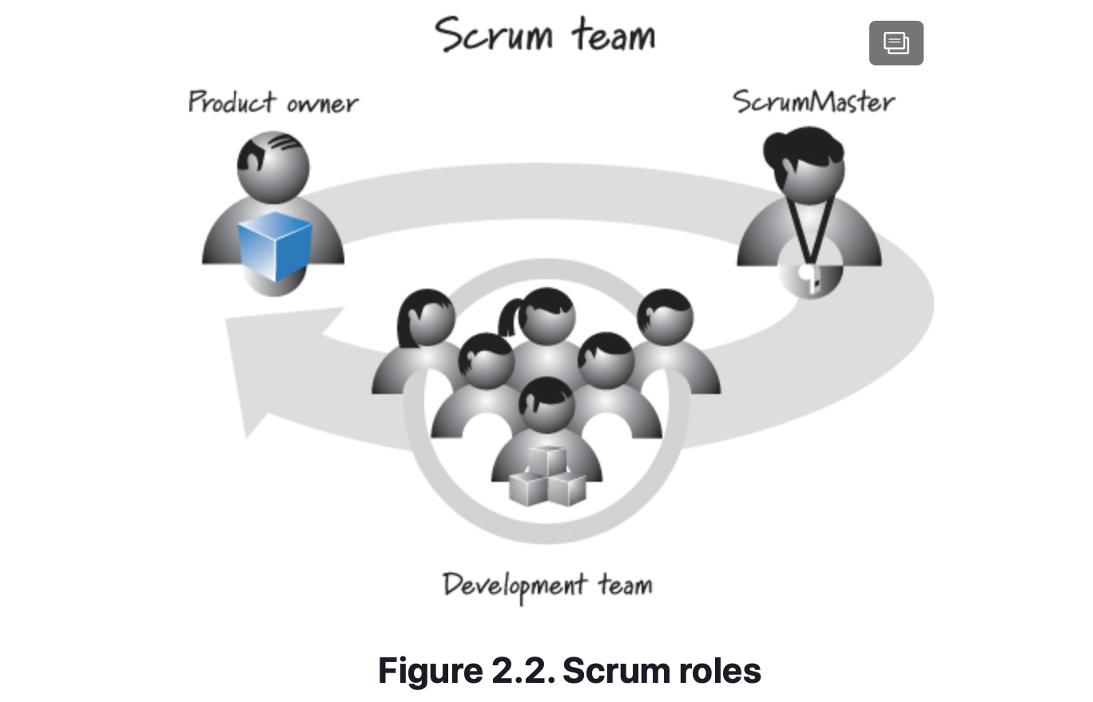
Scrum Framework
Scrum Roles
Scrum development efforts consist of one or more Scrum teams, each made up of three Scrum roles: product owner, ScrumMaster, and the development team.
There can be other roles when using Scrum, but the Scrum framework requires only the three listed here.

Slide 8
Scrum Framework
Product Owner
Empowered central point of product leadership.
“He” is the single authority responsible for deciding which features and functionality to build and the order in which to build them.
Maintains and communicates to all other participants a clear vision of what the Scrum team is trying to achieve. As such, the PO is responsible for the overall success of the solution being developed or maintained.
Has the obligation to make sure that the most valuable work possible.
Must be willing and able to answer questions soon after they are posed.
Notes:
See Chapter 9 for a detailed description of the product owner role.

Slide 9
Scrum Framework
ScrumMaster
The ScrumMaster helps everyone involved understand and embrace the Scrum values, principles, and practices.
“She” acts as a coach, providing process leadership and helping the Scrum team and the rest of the organization develop their own high-performance, organization-specific Scrum approach.
As a facilitator, the ScrumMaster helps the team resolve issues and make improvements to its use of Scrum.
She is also responsible for protecting the team from outside interference and takes a leadership role in removing impediments that inhibit team productivity (when the individuals themselves cannot reasonably resolve them).
Notes:
The roles of functional manager and project manager are covered in Chapter 13. See Chapter 10 for more details on the ScrumMaster role.

Slide 10
Scrum Framework
Development Team
Traditional software development approaches discuss various job types, such as architect, programmer, tester, database administrator, UI designer, and so on.
Scrum defines the role of a development team, which is simply a diverse, cross-functional collection of these types of people who are responsible for designing, building, and testing the desired product.
The development team self-organizes to determine the best way to accomplish the goal set out by the product owner.
The development team is typically five to nine people in size; its members must collectively have all of the skills needed to produce good-quality, working software.
Notes:
The roles of functional manager and project manager are covered in Chapter 13. See Chapter 10 for more details on the ScrumMaster role.

Slide 11
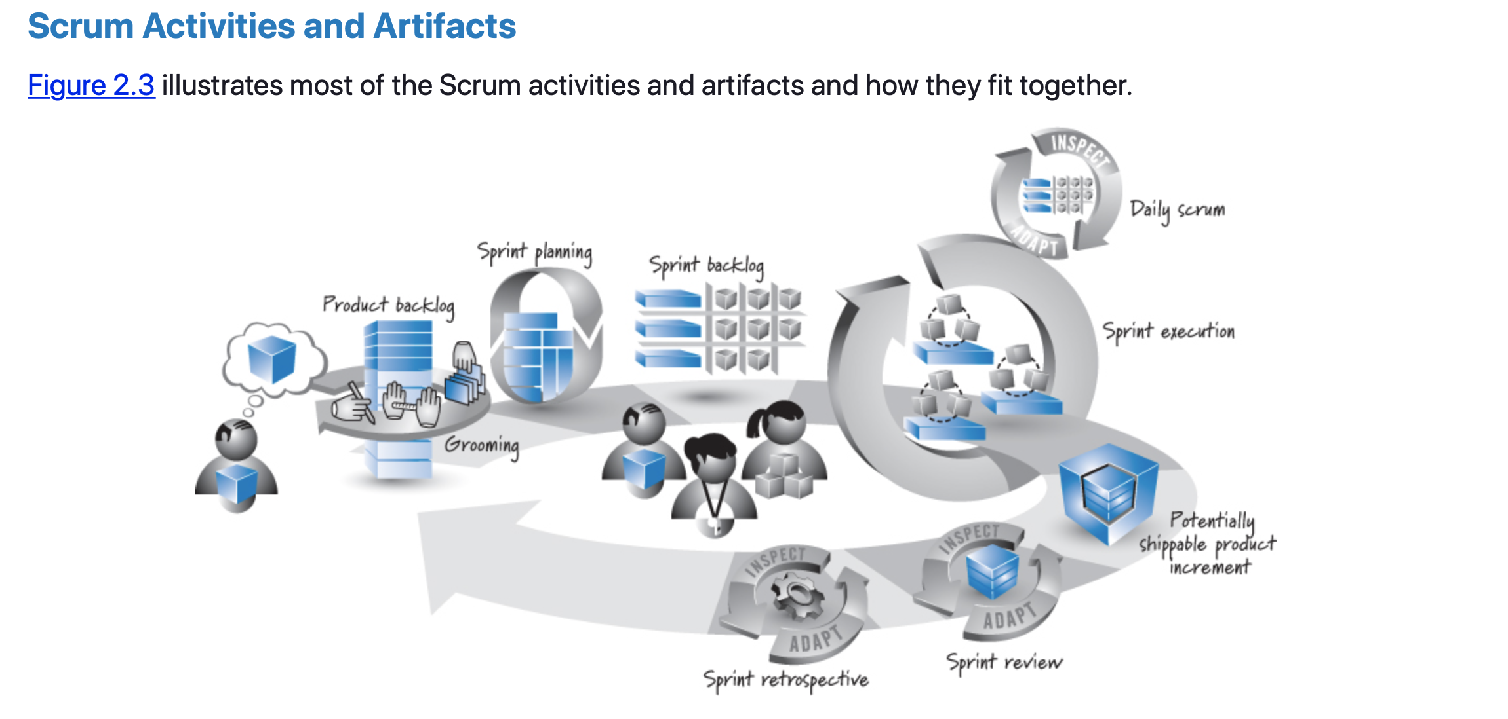
Scrum Framework
Scrum Activities and Artifacts
Let’s summarize the diagram, starting on the left side of the figure and working clockwise around the main looping arrow (the sprint).
Notes:
The product owner has a vision of what he wants to create (the big cube). Because the cube can be large, through an activity called grooming it is broken down into a set of features that are collected into a prioritized list called the product backlog.
A sprint starts with sprint planning, encompasses the development work during the sprint (called sprint execution), and ends with the review and retrospective. The sprint is represented by the large, looping arrow that dominates the center of the figure. The number of items in the product backlog is likely to be more than a development team can complete in a short-duration sprint. For that reason, at the beginning of each sprint, the development team must determine a subset of the product backlog items it believes it can complete—an activity called sprint planning, shown just to the right of the large product backlog cube.
To acquire confidence that the development team has made a reasonable commitment, the team members create a second backlog during sprint planning, called the sprint backlog. The sprint backlog describes, through a set of detailed tasks, how the team plans to design, build, integrate, and test the selected subset of features from the product backlog during that particular sprint.
Next is sprint execution, where the development team performs the tasks necessary to realize the selected features. Each day during sprint execution, the team members help manage the flow of work by conducting a synchronization, inspection, and adaptive planning activity known as the daily scrum. At the end of sprint execution the team has produced a potentially shippable product increment that represents some, but not all, of the product owner’s vision.
The Scrum team completes the sprint by performing two inspect-and-adapt activities. In the first, called the sprint review, the stakeholders and Scrum team inspect the product being built. In the second, called the sprint retrospective, the Scrum team inspects the Scrum process being used to create the product. The outcome of these activities might be adaptations that will make their way into the product backlog or be included as part of the team’s development process.
At this point the Scrum sprint cycle repeats, beginning anew with the development team determining the next most important set of product backlog items it can complete. After an appropriate number of sprints have been completed, the product owner’s vision will be realized and the solution can be released.

Slide 12
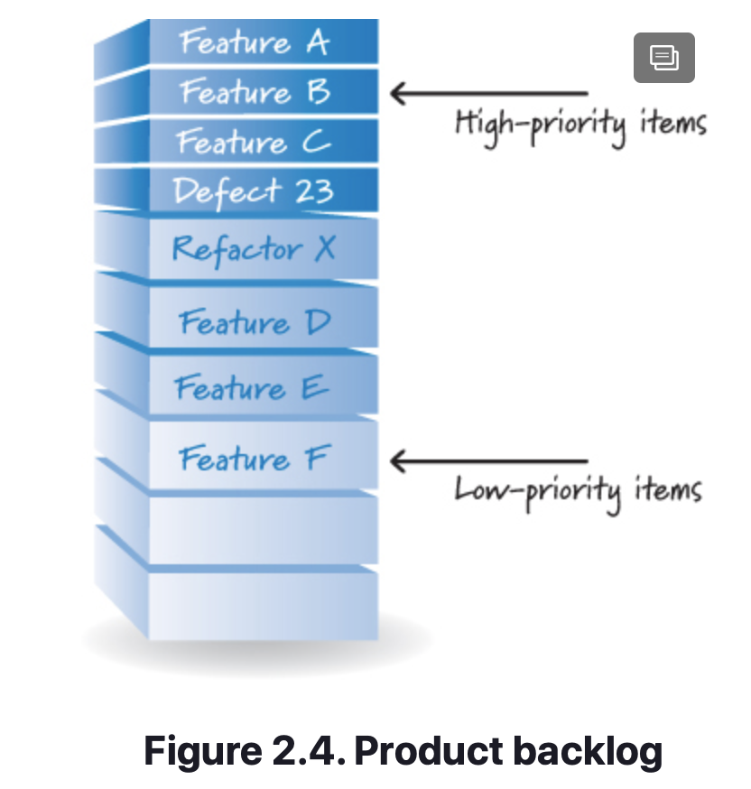
Scrum Framework
Product Backlog
The most valuable work first is prioritized.
The product owner, with input from the rest of the Scrum team and stakeholders, is ultimately responsible for determining and managing the sequence of this work and communicating it in the form of a prioritized (or ordered) list known as the product backlog (see Figure 2.4).
On new-product development the product backlog items initially are features required to meet the product owner’s vision. For ongoing product development, the product backlog might also contain new features, changes to existing features, defects needing repair, technical improvements, and so on.

Slide 13
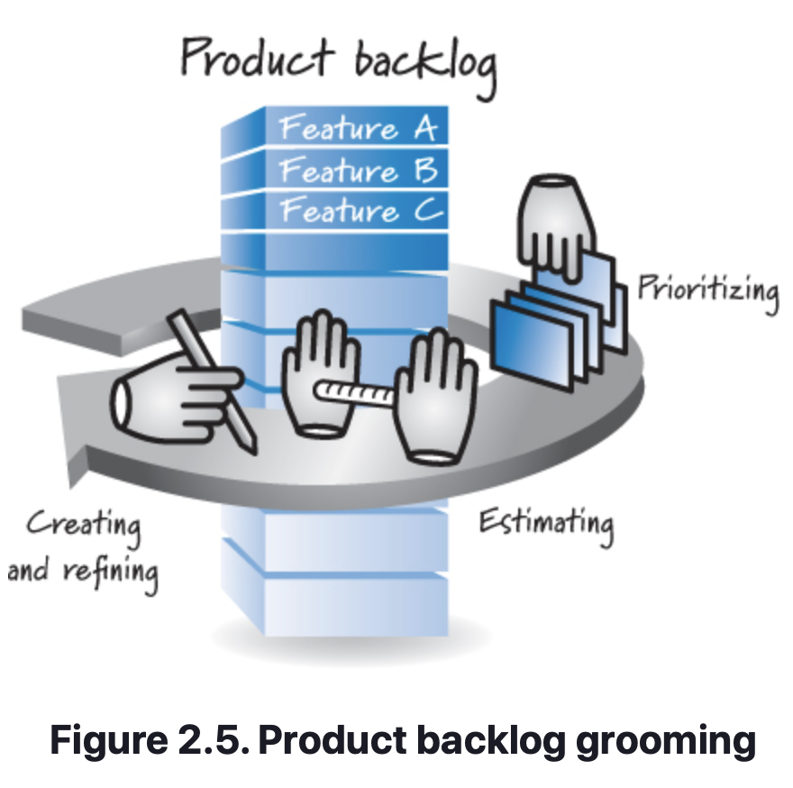
Scrum Framework
Product Backlog
The product owner collaborates with internal and external stakeholders to gather and define the product backlog items.
He then ensures that product backlog items are placed in the correct sequence (using factors such as value, cost, knowledge, and risk) so that the high-value items appear at the top of the product backlog and the lower-value items appear toward the bottom.
The product backlog is a constantly evolving artifact. Items can be added, deleted, and revised by the product owner as business conditions change, or as the Scrum team’s understanding of the product grows (through feedback on the software produced during each sprint).
Overall the activity of creating and refining product backlog items, estimating them, and prioritizing them is known as grooming.

Slide 14
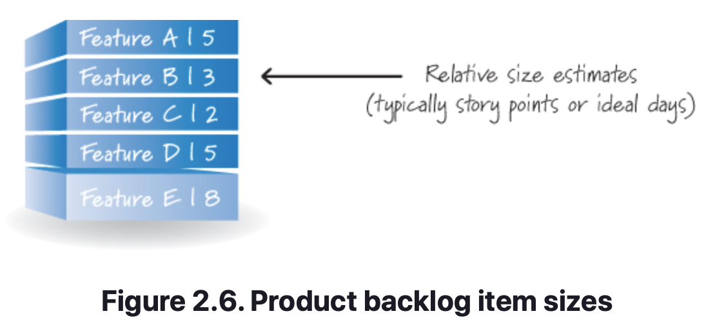
Scrum Framework
Product Backlog
Size equates to cost, and product owners need to know the cost of an item to properly determine its priority.
Scrum does not dictate which, if any, size measure to use with product backlog items. In practice, many teams use a relative size measure such as story points or ideal days.
A relative size measure expresses the overall size of an item in such a way that the absolute value is not considered, but the relative size of an item compared to other items is considered.
For example, in Figure 2.6, feature C is size 2 and feature E is size 8. What we can conclude is that feature E is about four times larger than feature C.
Notes:
relative size measure. A means of expressing the overall size of an item where the absolute value is not considered, but the relative size of an item compared to other items is considered. For example, an item of size 2 is half the size of an item of size 4, but we have no idea how big an item of size 2 or 4 is in some absolute sense.
ideal day. A unit for estimating the size of product backlog items based on how long an item would take to complete if it were the only work being performed, there were no interruptions, and all resources necessary to complete the work were immediately available.
story point. A measure of the relative size of product backlog items that takes into account factors such as complexity and physical size. Typically determined by engaging in Planning Poker.
Planning Poker. A consensus-based technique for the relative sizing of product backlog items.

Slide 15
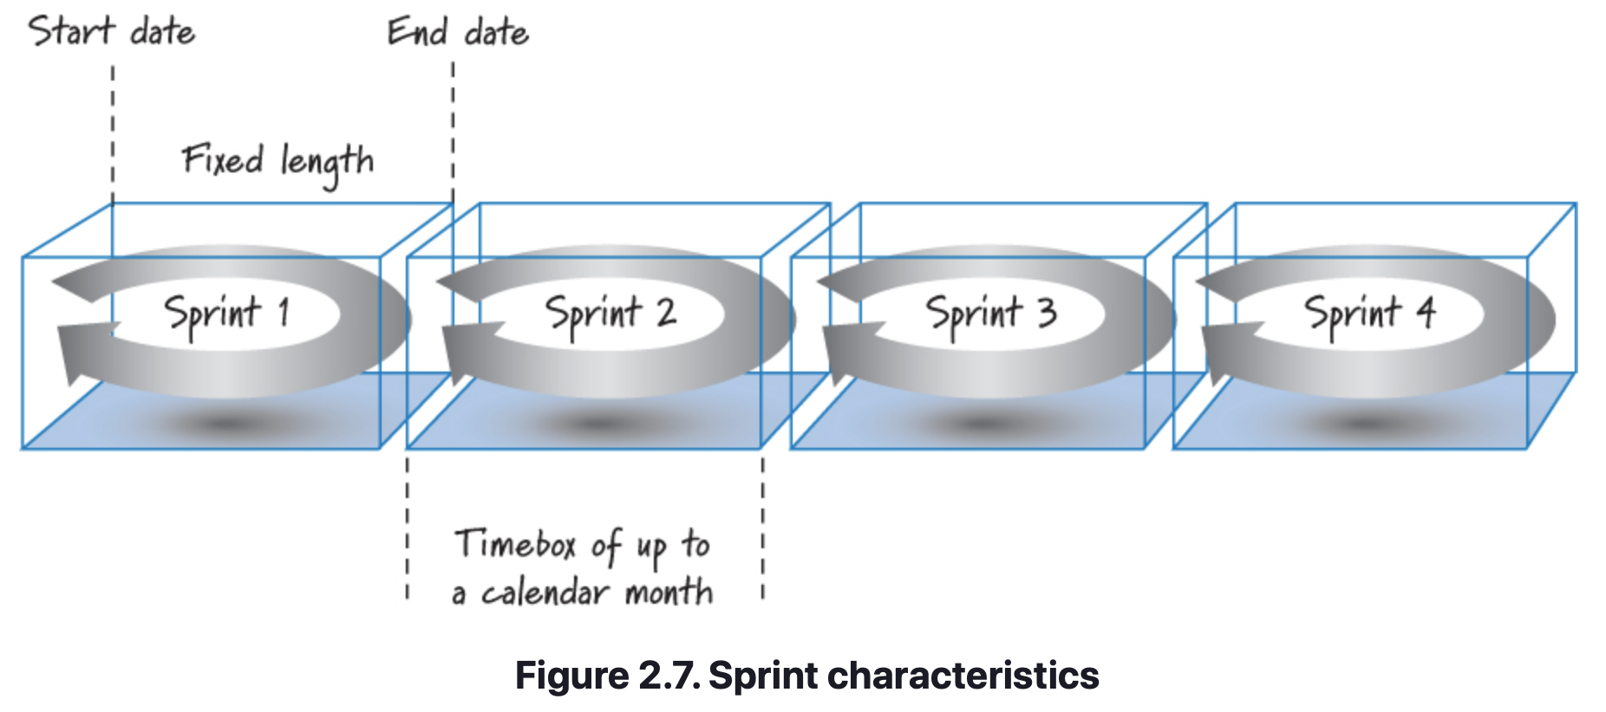
Scrum Framework
Sprints
In Scrum, work is performed in iterations or cycles of up to a calendar month called sprints (see Figure 2.7). The work completed in each sprint should create something of tangible value to the customer or user.
Notes:
Sprints are timeboxed so they always have a fixed start and end date, and generally they should all be of the same duration. A new sprint immediately follows the completion of the previous sprint. As a rule we do not permit any goal-altering changes in scope or personnel during a sprint; however, business needs sometimes make adherence to this rule impossible.

Slide 16
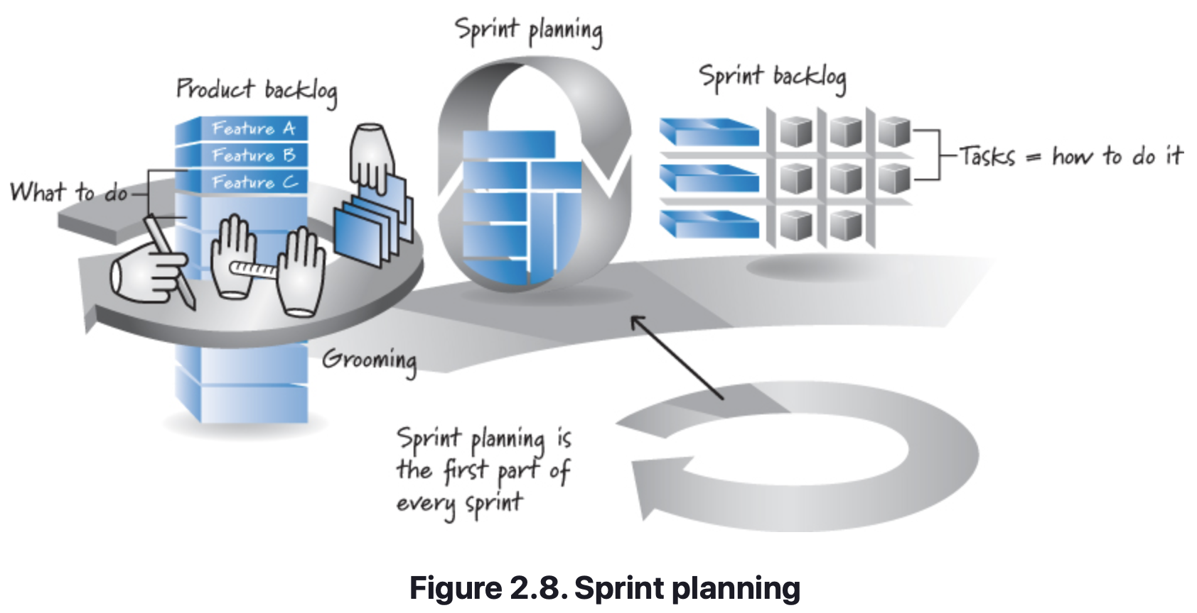
Scrum Framework
Sprint Planning
A product backlog may represent many weeks or months of work, which is much more than can be completed in a single, short sprint. To determine the most important subset of product backlog items to build in the next sprint, the product owner, development team, and ScrumMaster perform sprint planning (see Figure 2.8).

Slide 17
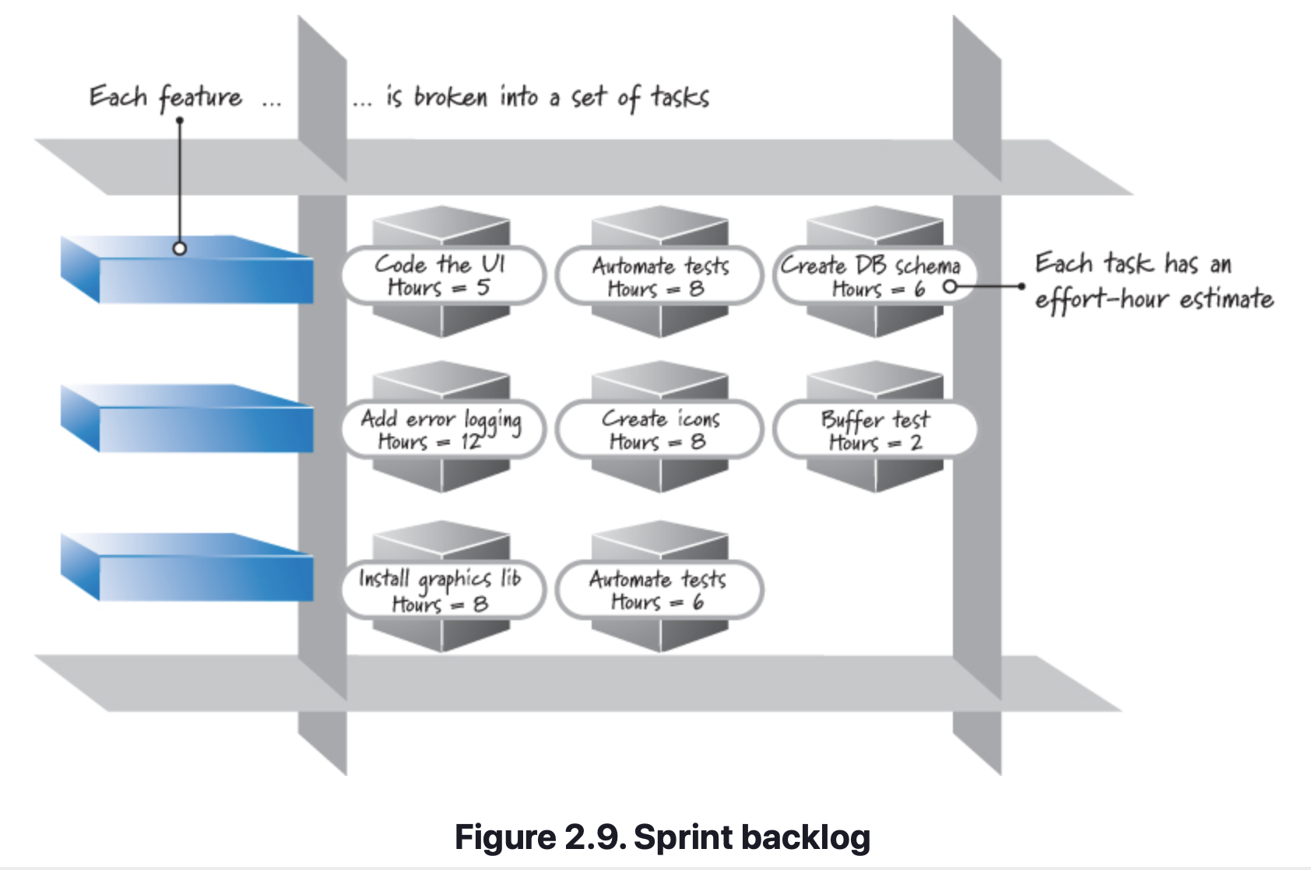
Scrum Framework
Sprint Planning
During sprint planning, the product owner and development team agree on a sprint goal that defines what the upcoming sprint is supposed to achieve.
Using this goal, the development team reviews the product backlog and determines the high-priority items that the team can realistically accomplish in the upcoming sprint while working at a sustainable pace—a pace at which the development team can comfortably work for an extended period of time.
To acquire confidence in what they can get done, many development teams break down each targeted feature into a set of tasks. The collection of these tasks, along with their associated product backlog items, forms a second backlog called the sprint backlog (see Figure 2.9).
Notes:
What Is a Sprint Goal?
Each sprint can be summarized by a sprint goal that describes the business purpose and value of the sprint. Typically the sprint goal has a clear, single focus, such as
• Support initial report generation.
• Load and curate North America map data.
• Demonstrate the ability to send a text message through an integrated software, firmware, and hardware stack.
There are times when a sprint goal might be multifaceted, for example, “Get basic printing working and support search by date.”
During sprint planning, the development team should help refine and agree to the sprint goal and use it to determine the product backlog items that it can complete by the end of the sprint (see Chapter 19 for more details). These product backlog items serve to further elaborate the sprint goal.

Slide 18
Scrum Framework
Sprint Planning
The development team then provides an estimate (typically in hours) of the effort required to complete each task. Breaking product backlog items into tasks is a form of design and just-in-time planning for how to get the features done.
Most Scrum teams performing sprints of two weeks to a month in duration try to complete sprint planning in about four to eight hours.
During this time there are several approaches that can be used.
The approach that the author uses most often follows a simple cycle: Select a product backlog item (whenever possible, the next-most-important item as defined by the product owner), break the item down into tasks, and determine if the selected item will reasonably fit within the sprint (in combination with other items targeted for the same sprint). If it does fit and there is more capacity to complete work, repeat the cycle until the team is out of capacity to do any more work.
Notes:
An alternative approach would be for the product owner and team to select all of the target product backlog items at one time. The development team alone does the task breakdowns to confirm that it really can deliver all of the selected product backlog items.

Slide 19
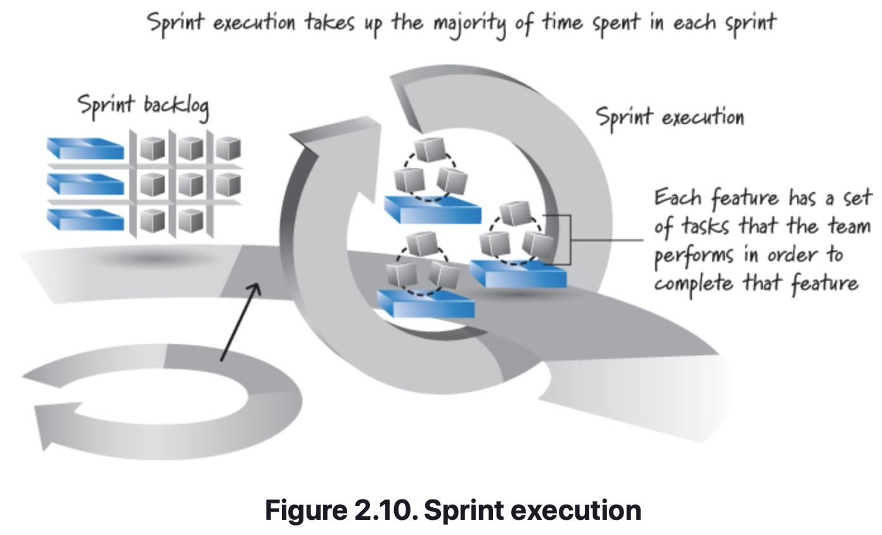
Scrum Framework
Sprint Execution
Once the Scrum team finishes sprint planning and agrees on the content of the next sprint, the development team, guided by the ScrumMaster’s coaching, performs all of the task-level work necessary to get the features done (see Figure 2.10), where “done” means there is a high degree of confidence that all of the work necessary for producing good-quality features has been completed.
Notes:
Exactly what tasks the team performs depends of course on the nature of the work (for example, are we building software and what type of software, or are we building hardware, or is this marketing work?).
Nobody tells the development team in what order or how to do the task-level work in the sprint backlog. Instead, team members define their own task-level work and then self-organize in any manner they feel is best for achieving the sprint goal.

Slide 20
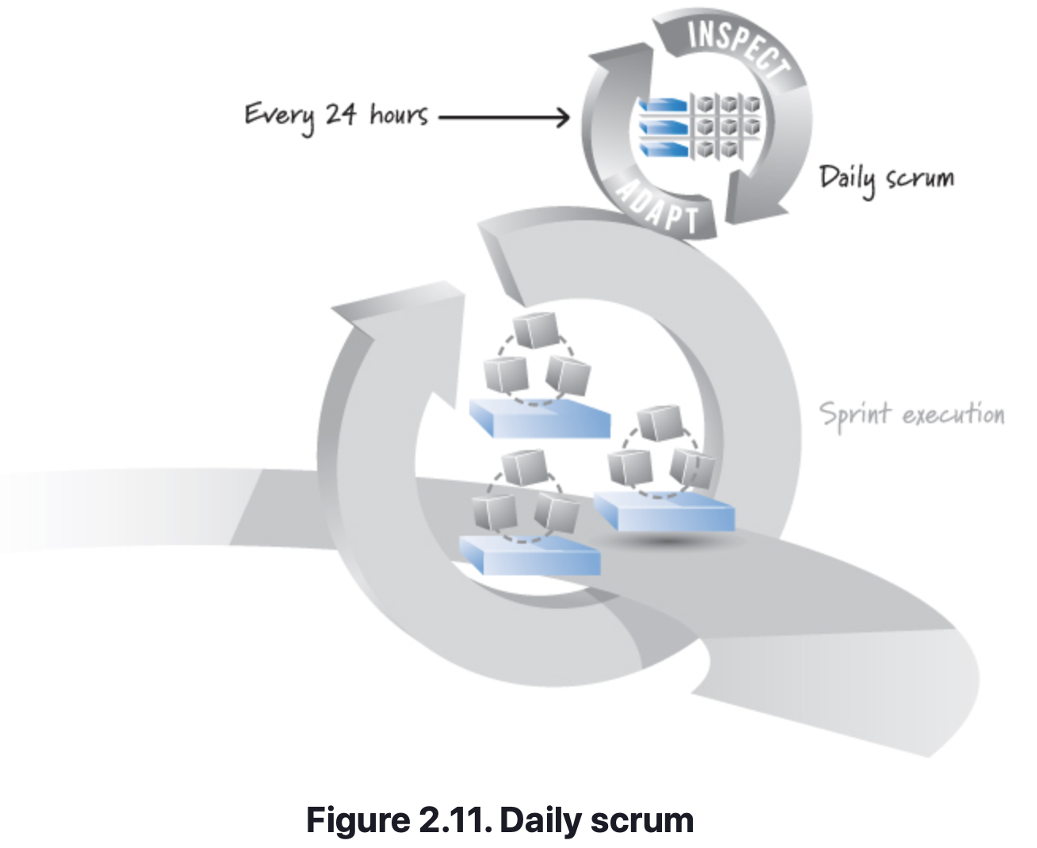
Scrum Framework
Daily Scrum
Each day of the sprint, ideally at the same time, the development team members hold a timeboxed (15 minutes or less) daily scrum (see Figure 2.11). This inspect-and-adapt activity is sometimes referred to as the daily stand-up because of the common practice of everyone standing up during the meeting to help promote brevity.
Notes:
Exactly what tasks the team performs depends of course on the nature of the work (for example, are we building software and what type of software, or are we building hardware, or is this marketing work?).
Nobody tells the development team in what order or how to do the task-level work in the sprint backlog. Instead, team members define their own task-level work and then self-organize in any manner they feel is best for achieving the sprint goal.

Slide 21
Scrum Framework
Daily Scrum
A common approach to performing the daily scrum has the ScrumMaster facilitating and each team member taking turns answering three questions for the benefit of the other team members:
What did I accomplish since the last daily scrum?
What do I plan to work on by the next daily scrum?
What are the obstacles or impediments that are preventing me from making progress?
By answering these questions, everyone understands the big picture of what is occurring, how they are progressing toward the sprint goal, any modifications they want to make to their plans for the upcoming day’s work, and what issues need to be addressed.
The daily scrum is essential for helping the development team manage the fast, flexible flow of work within a sprint.
Notes:
The daily scrum is not a problem-solving activity. Rather, many teams decide to talk about problems after the daily scrum and do so with a small group of interested people. The daily scrum also is not a traditional status meeting, especially the kind historically called by project managers so that they can get an update on the project’s status. A daily scrum, however, can be useful to communicate the status of sprint backlog items among the development team members. Mainly, the daily scrum is an inspection, synchronization, and adaptive daily planning activity that helps a self-organizing team do its job better.

Slide 22
Scrum Framework
Daily Scrum
Optional Videos to Watch:
Good example of a daily scrum (aka – standup) being held.
Great explanation of why they are held and key details to successful execution.

Slide 23
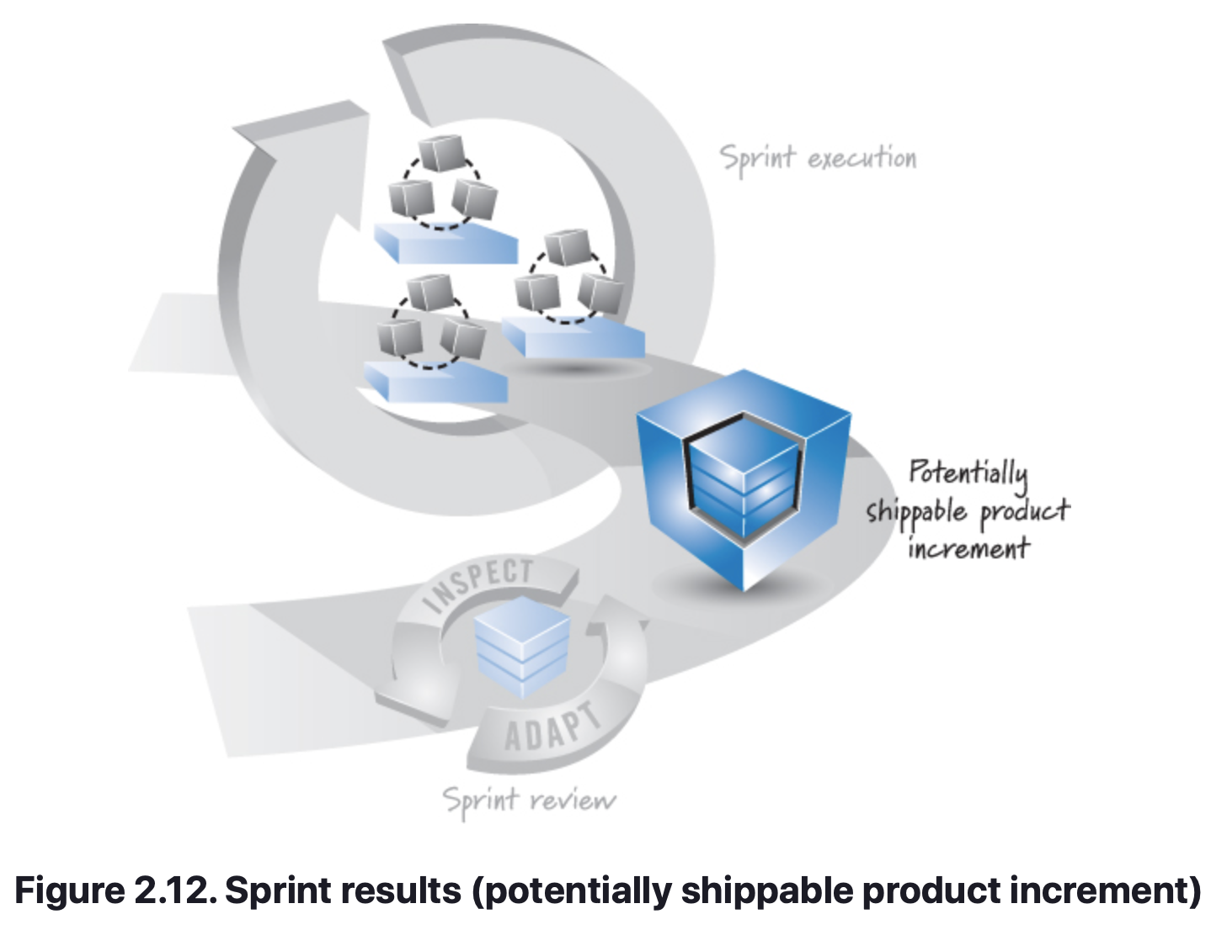
Scrum Framework
Definition of “Done”
In Scrum, we refer to the sprint results as a potentially shippable product increment (see Figure 2.12), meaning that whatever the Scrum team agreed to do is really done according to its agreed-upon definition of done. This definition specifies the degree of confidence that the work completed is of good quality and is potentially shippable. For example, when developing software, a bare-minimum definition of done should yield a complete slice of product functionality that is designed, built, integrated, tested, and documented.
Notes:
Exactly what tasks the team performs depends of course on the nature of the work (for example, are we building software and what type of software, or are we building hardware, or is this marketing work?).
Nobody tells the development team in what order or how to do the task-level work in the sprint backlog. Instead, team members define their own task-level work and then self-organize in any manner they feel is best for achieving the sprint goal.

Slide 24
Scrum Framework
Definition of “Done”
To be clear, “potentially shippable” does not mean that what got built must actually be shipped. Shipping (or deploying) is a business decision, which is frequently influenced by things such as “Do we have enough features or enough of a customer workflow to justify a customer deployment?” or “Can our customers absorb another change given that we just gave them a release two weeks ago?”
Potentially shippable is better thought of as a state of confidence that what got built in the sprint is actually done, meaning that there isn’t materially important undone work (such as important testing or integration and so on) that needs to be completed before we can ship the results from the sprint, if shipping is our business desire.
For example, in the early stages of game development, having features that are potentially shippable might not be economically feasible or desirable (given the exploratory nature of early game development). In these situations, an appropriate definition of done might be a slice of product functionality that is sufficiently functional and usable to generate feedback that enables the team to decide what work should be done next or how to do it.

Slide 25
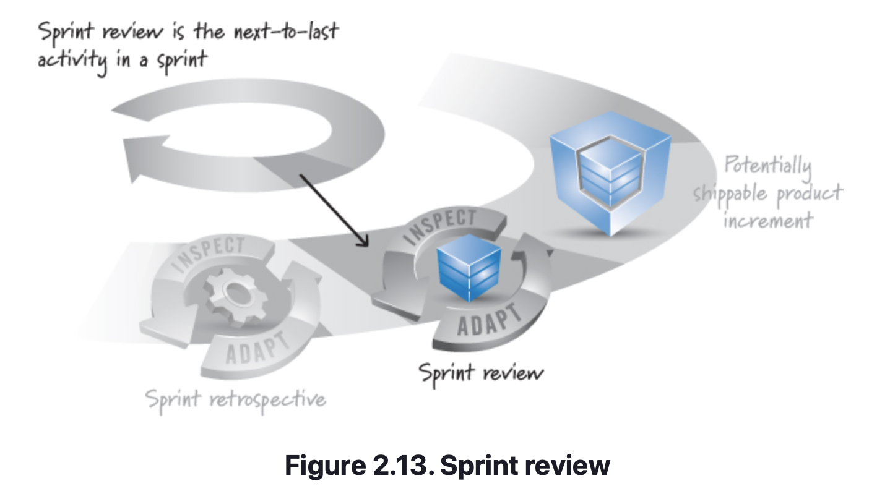
Scrum Framework
Sprint Review
At the end of the sprint there are two additional inspect-and-adapt activities. One is called the sprint review (see Figure 2.13).
Notes:
The goal of this activity is to inspect and adapt the product that is being built. Critical to this activity is the conversation that takes place among its participants, which include the Scrum team, stakeholders, sponsors, customers, and interested members of other teams. The conversation is focused on reviewing the just-completed features in the context of the overall development effort. Everyone in attendance gets clear visibility into what is occurring and has an opportunity to help guide the forthcoming development to ensure that the most business-appropriate solution is created.
A successful review results in bidirectional information flow. The people who aren’t on the Scrum team get to sync up on the development effort and help guide its direction. At the same time, the Scrum team members gain a deeper appreciation for the business and marketing side of their product by getting frequent feedback on the convergence of the product toward delighted customers or users. The sprint review therefore represents a scheduled opportunity to inspect and adapt the product. As a matter of practice, people outside the Scrum team can perform intra-sprint feature reviews and provide feedback to help the Scrum team better achieve its sprint goal.

Slide 26
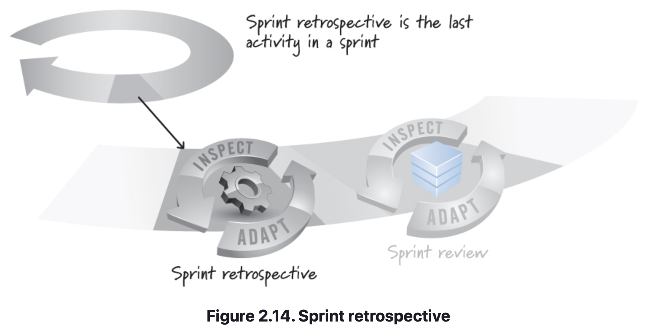
Scrum Framework
Sprint Retrospective
The second inspect-and-adapt activity at the end of the sprint is the sprint retrospective (see Figure 2.14). This activity frequently occurs after the sprint review and before the next sprint planning.
Notes:
Whereas the sprint review is a time to inspect and adapt the product, the sprint retrospective is an opportunity to inspect and adapt the process. During the sprint retrospective the development team, ScrumMaster, and product owner come together to discuss what is and is not working with Scrum and associated technical practices. The focus is on the continuous process improvement necessary to help a good Scrum team become great. At the end of a sprint retrospective the Scrum team should have identified and committed to a practical number of process improvement actions that will be undertaken by the Scrum team in the next sprint.
After the sprint retrospective is completed, the whole cycle is repeated again—starting with the next sprint-planning session, held to determine the current highest-value set of work for the team to focus on.

Slide 27
Scrum Framework
Closing
This chapter described core Scrum practices, focusing on an end-to-end description of the Scrum framework’s roles, activities, and artifacts. There are other practices, such as higher-level planning and progress-tracking practices, that many Scrum teams use. These will be described in subsequent chapters.

Slide 28
Agile principles
Chapter 3

Slide 29
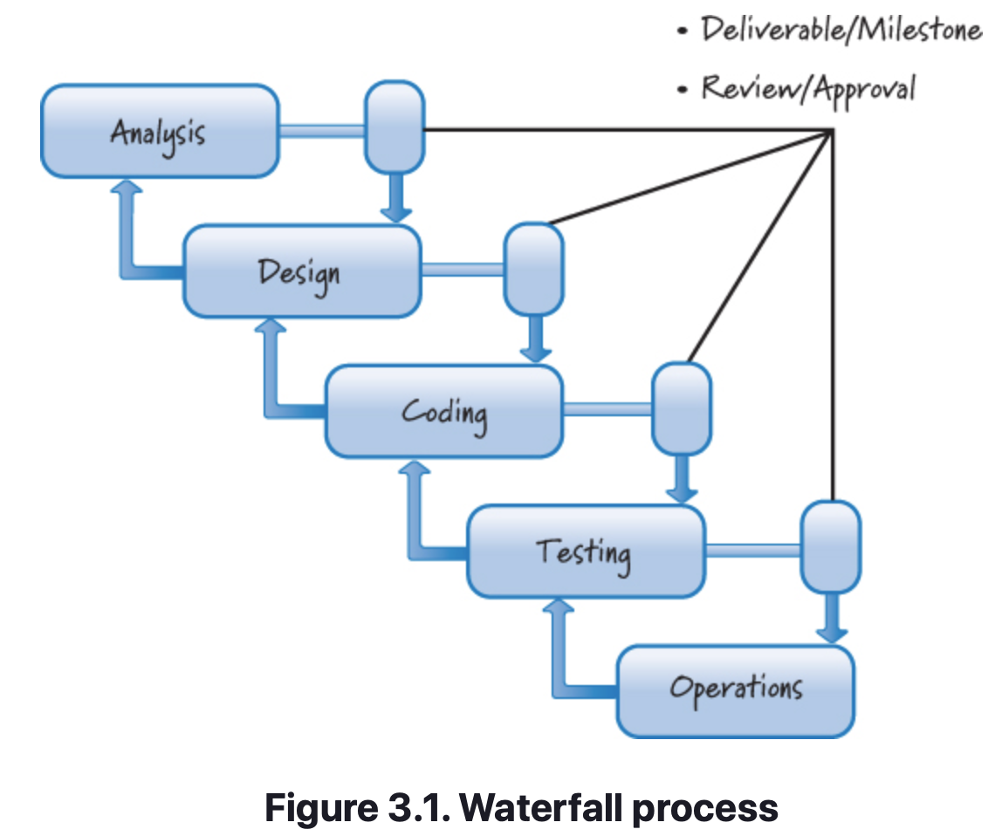
Agile Principles
Overview
One pure form of traditional, plan-driven development frequently goes by the term waterfall (see Figure 3.1).
Waterfall is just one example of a broader class of plan-driven processes (also known as traditional, sequential, anticipatory, predictive, or prescriptive development processes).

Slide 30
Agile Principles
Overview
Plan-driven processes are so named because they attempt to plan for and anticipate up front all of the features a user might want in the end product, and to determine how best to build those features.
The idea here is that the better the planning, the better the understanding, and therefore the better the execution.
Plan-driven processes are often called sequential processes because practitioners perform, in sequence, a complete requirements analysis followed by a complete design followed in turn by coding/building and then testing.

Slide 31
Agile Principles
Overview
Plan-driven development works well when applied to problems that are well defined, predictable, and unlikely to undergo any significant change.
The challenge is that most product (and system) development efforts are anything but predictable, especially at the beginning.
Even if a plan-driven process repeatedly produces disappointing results, many organizations continue to apply the same approach, sure that if they just do it better, their results will improve.
The problem, however, is not with the execution. It’s that plan-driven approaches are based on a set of beliefs that do not match the uncertainty, which is inherent in most product development efforts.
Notes:
So, while a plan-driven process gives the impression of an orderly, accountable, and measurable approach, that impression can lead to a false sense of security.
After all, developing a product rarely goes as planned.

Slide 32
Agile Principles
Overview
Scrum, on the other hand, is based on a different set of beliefs—ones that are mapped well to problems with enough uncertainty to make high levels of predictability difficult.
The principles that are described in this chapter are drawn from a number of sources, including the Agile Manifesto (Beck et al. 2001), lean product development (Reinertsten 2009b; Poppendieck and Poppendieck 2003), and “The Scrum Guide” (Schwaber and Sutherland 2011).
These principles are organized into several categories as shown in Figure 3.2.

Slide 33
Agile Principles
Overview

Slide 34
Agile Principles
Variability and Uncertainty
Scrum leverages the variability and uncertainty in product development to create innovative solutions. There are four principles related to this topic:
Embrace helpful variability.
Employ iterative and incremental development.
Leverage variability through inspection, adaptation, and transparency.
Reduce all forms of uncertainty simultaneously.

Slide 35
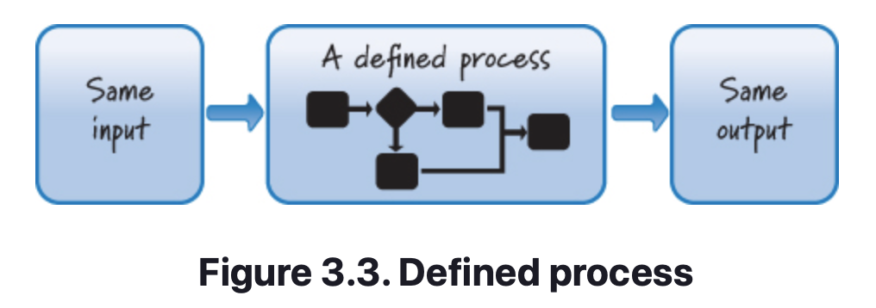
Agile Principles
Embrace helpful variability
Plan-driven processes treat product development like manufacturing—they shun variability and encourage conformance to a defined process.
The problem is that product development is not at all like product manufacturing.
In manufacturing the goal is to take a fixed set of requirements and follow a sequential set of well-understood steps to manufacture a finished product that is the same (within a defined variance range) every time (see Figure 3.3).
In product development, however, the goal is to create the unique single instance of the product, not to manufacture the product. This single instance is analogous to a unique recipe.

Slide 36
Agile Principles
Employ iterative and incremental development
Plan-driven, sequential development assumes that teams will get things right up front and that most or all of the product pieces will come together late in the effort.
Scrum, on the other hand, is based on iterative and incremental development. Although these two terms are frequently used as if they were a single concept, iterative development is actually distinct from incremental development.
Iterative development acknowledges that we will probably get things wrong before we get them right and that we will do things poorly before we do them well. As such, iterative development is a planned rework strategy.
Incremental development is based on the age-old principle of “Build some of it before you build all of it.” This avoids having one large, big-bang-style event at the end of development where all the pieces must come together and the entire product is delivered at one time.
Notes:
Iterative development is an excellent way to improve the product as it is being developed. The biggest downside to iterative development is that in the presence of uncertainty it can be difficult up front to determine (plan) how many improvement passes will be necessary.
Incremental Development - break the product into smaller pieces so that we can build some of it, learn how each piece is to survive in the environment in which it must exist, adapt based on what we learn, and then build more of it.
Incremental development gives us important information that allows us to adapt our development effort and to change how we proceed. The biggest drawback to incremental development is that by building in pieces, we risk missing the big picture (we see the trees but not the forest).
Scrum leverages the benefits of both iterative and incremental development, while negating the disadvantages of using them individually.

Slide 37
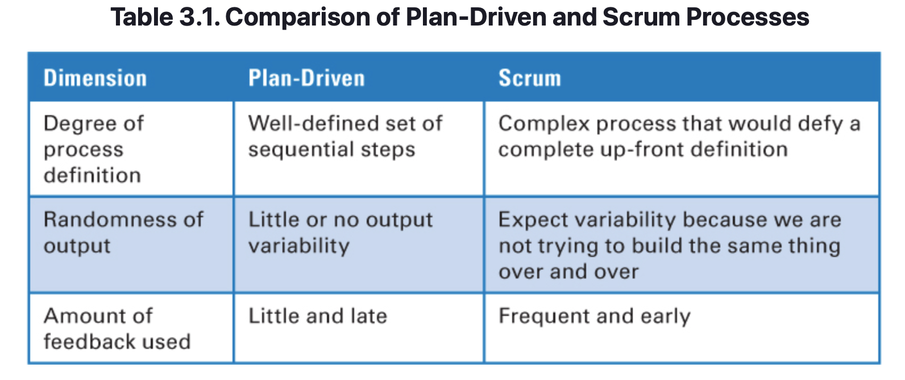
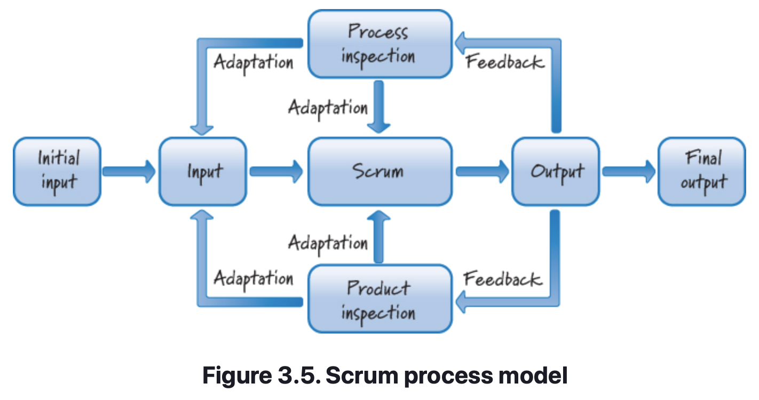
Agile Principles
Leverage Variability through Inspection, Adaptation, and Transparency
Plan-driven processes and Scrum are fundamentally different along several dimensions, see Table 3.1.
At the heart of Scrum are the principles of inspection, adaptation, and transparency (referred to collectively by Schwaber and Beedle 2001 as empirical process control). In Scrum, we inspect and adapt not only what we are building but also how we are building it, see Figure 3.5.
To do this well, transparency is fundamental: all of the information that is important to producing a product must be available to the people involved in creating the product.
Notes:
Empirical process control. A style of work that leverages the principles of inspection, adaptation, and transparency. Contrast with defined process.
Transparency makes inspection possible, which is needed for adaptation. Transparency also allows everyone concerned to observe and understand what is happening. It leads to more communication and it establishes trust (both in the process and among team members).

Slide 38
Agile Principles
Reduce All Forms of Uncertainty Simultaneously
Developing new products is a complex endeavor with a high degree of uncertainty. That uncertainty can be divided into two broad categories (Laufer 1996):
End uncertainty (what uncertainty)—uncertainty surrounding the features of the final product
Means uncertainty (how uncertainty)—uncertainty surrounding the process and technologies used to develop a product
Traditional, sequential development processes focus first on eliminating all end uncertainty by fully defining up front what is to be built, and only then addressing means uncertainty.
In Scrum, we do not constrain ourselves by fully addressing one type of uncertainty before we address the next type. Instead, we take a more holistic approach and focus on simultaneously reducing all uncertainties.
Notes:
The simplistic, linear approach to uncertainty reduction is ill suited to the complex domain of product development, where our actions and the environment in which we operate mutually constrain one another. For example:
• We decide to build a feature (our action).
• We then show that feature to a customer, who, once he sees it, changes his mind about what he really wants, or realizes that he did not adequately convey the details of the feature (our action elicits a response from the environment).
• We make design changes based on the feedback (the environment’s reaction influences us to take another unforeseen action).

Slide 39
Agile Principles
Prediction and Adaption
When using Scrum, the team is constantly balancing the desire for prediction with the need for adaptation. There are five agile principles related to this topic:
Keep options open.
Accept that you can’t get it right up front.
Favor an adaptive, exploratory approach.
Embrace change in an economically sensible way.
Balance predictive up-front work with adaptive just-in-time work.

Slide 40
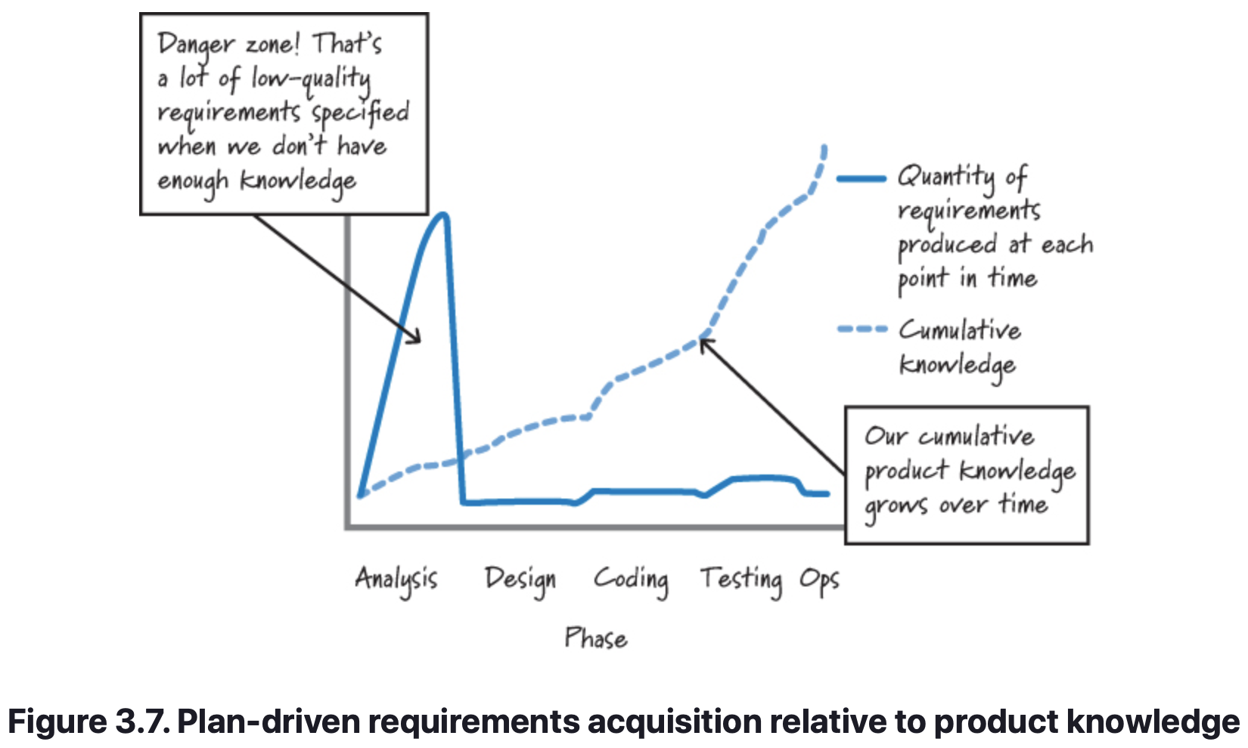
Agile Principles
Accept That You Can’t Get It Right Up Front
Plan-driven processes not only mandate full requirements and a complete plan; they also assume that we can “get it right” up front.
The reality is that it is very unlikely that we can get all of the requirements, or the detailed plans based on those requirements, correct up front.
In Scrum, we acknowledge that we can’t get all of the requirements or the plans right up front. In fact, we believe that trying to do so could be dangerous because we are likely missing important knowledge, leading to the creation of a large quantity of low-quality requirements (see Figure 3.7).
Notes:
This figure illustrates that when using a plan-driven, sequential process, a large number of requirements are produced early on when we have the least cumulative knowledge about the product. This approach is risky, because there is an illusion that we have eliminated end uncertainty. It is also potentially very wasteful when our understanding improves or things change (as I will describe shortly).
With Scrum, we still produce some requirements and plans up front, but just sufficiently, and with the assumption that we will fill in the details of those requirements and plans as we learn more about the product we are building. After all, even if we think we’re 100% certain about what to build and how to organize up front the work to build it, we will learn where we are wrong as soon as we subject our early incremental deliverables to the environment in which they must exist. At that point all of the inconvenient realities of what is really needed will drive us to make changes.

Slide 41
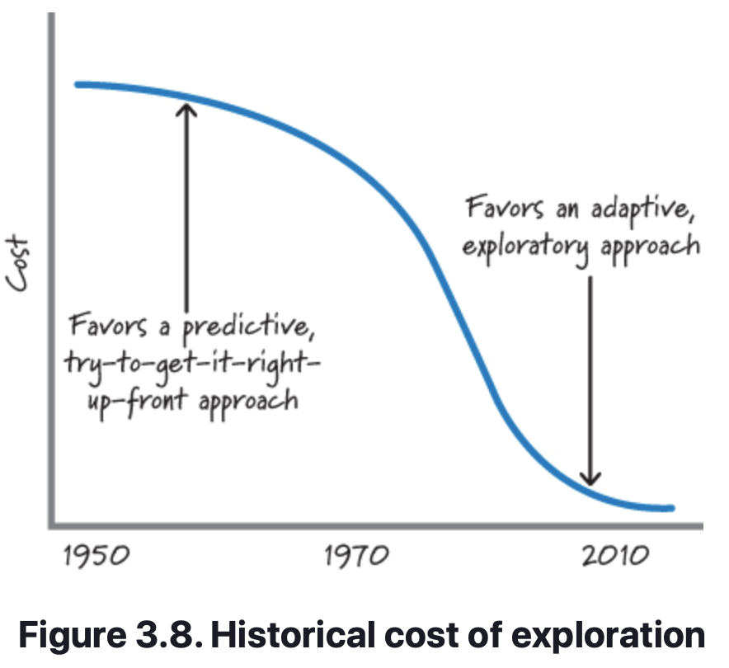
Agile Principles
Favor an Adaptive, Exploratory Approach
Plan-driven, sequential processes focus on using/exploiting what is currently known and predicting what isn’t known. Scrum favors a more adaptive, trial-and-error approach based on appropriate use of exploration.
Exploration refers to times when we choose to gain knowledge by doing some activity, such as building a prototype, creating a proof of concept, performing a study, or conducting an experiment. In other words, when faced with uncertainty, we buy information by exploring.
Tools and technologies impact the cost of exploration. Historically software product development exploration has been expensive, a fact that favored a more predictive, try-to-get-it-right-up-front approach (see Figure 3.8).
Notes:
As an example, in my freshman year at Georgia Tech (early 1980s), I (briefly) used punch cards—a tool that, like a typewriter, made you loathe to make any mistakes or modifications. It was hard to embrace the concept of “Let’s quickly try that out and see what happens” when, with each potential solution, you had to painstakingly create punch cards, get in the queue for the mainframe, and wait up to 24 hours to get validation of your solution. Even the cost of a simple typo was at least a day in the schedule. A waterfall-style process that allowed for careful consideration of current knowledge and prediction in the presence of uncertainty in an attempt to arrive at a good solution just made economic sense.
Fortunately, tools and technologies have gotten better and the cost of exploring has come way down. There is no longer an economic disincentive to explore. In fact, nowadays, it’s often cheaper to adapt to user feedback based on building something fast than it is to invest in trying to get everything right up front. Good thing, too, because the context (the surrounding technologies) in which our solutions must exist is getting increasingly more complex.
In Scrum, if we have enough knowledge to make an informed, reasonable step forward with our solution, we advance. However, when faced with uncertainty, rather than trying to predict it away, we use low-cost exploration to buy relevant information that we can then use to make an informed, reasonable step forward with our solution. The feedback from our action will help us determine if and when we need further exploration.

Slide 42
Agile Principles
Embrace Change in an Economically Sensible Way
When using sequential development, change is substantially more expensive late than it is early on.
To avoid late changes, sequential processes seek to carefully control and minimize any changing requirements or designs by improving the accuracy of the predictions about what the system needs to do or how it is supposed to do it.
Unfortunately, being excessively predictive in early-activity phases often has the opposite effect. It not only fails to eliminate change; it actually contributes to deliveries that are late and over budget as well.
In Scrum, we assume that change is the norm and believe that we can’t predict away the inherent uncertainty that exists during product development by working longer and harder up front. Thus, we must be prepared to embrace change.
Notes:
We can achieve that goal by managing the amount of work in process and the flow of that work so that the cost of change when using Scrum is less affected by time than it is with sequential projects.
Regardless of which product development approach we use, we want the following relationship to be true: a small change in requirements should yield a proportionally small change in implementation and therefore in cost (obviously we would expect a larger change to cost more). Another desirable property of this relationship is that we want it to be true regardless of when the change request is made.
With Scrum, we produce many work products (such as detailed requirements, designs, and test cases) in a just-in-time fashion, avoiding the creation of potentially unnecessary artifacts. As a result, when a change is made, there are typically far fewer artifacts or constraining decisions based on assumptions that might be discarded or reworked, thus keeping the cost more proportional to the size of the requested change.
Using sequential development, the early creation of artifacts and push for premature decision making ultimately mean that the cost of a change rises rapidly over time as inventory grows. This causes the inflection point (where the line begins to aggressively climb up) on the traditional curve in Figure 3.11 to occur early. When developing with Scrum, there does come a time when the cost of change will no longer be proportional to the size of the request, but this point in time (as illustrated by the inflection point on the Scrum curve in Figure 3.11) occurs later.

Slide 43
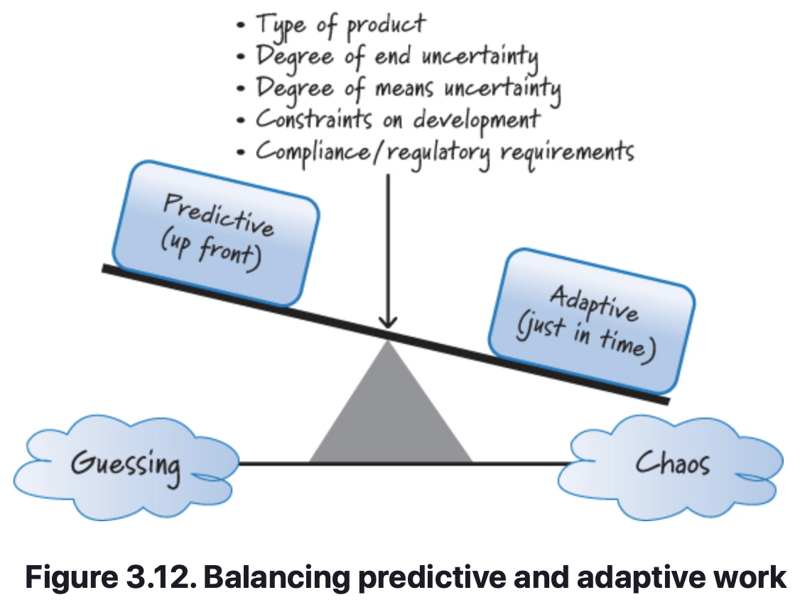
Agile Principles
Balance Predictive Up-Front Work with Adaptive Just-in-Time Work
A fundamental belief of plan-driven development is that detailed up-front requirements and planning are critical and should be completed before moving on to later stages.
In Scrum, we believe that up-front work should be helpful without being excessive.
That does not mean we sacrifice the quality of requirements or planning work up front.
Scrum is about finding balance—balance between predictive up-front work and adaptive just-in-time work (see Figure 3.12, adapted from a picture by Cohn 2009).
Notes:
When developing a product, the balance point should be set in an economically sensible way to maximize the amount of ongoing adaptation based on fast feedback and minimize the amount of up-front prediction, while still meeting compliance, regulatory, and/or corporate objectives.
Exactly how that balance is achieved is driven in part by the type of product being built, the degree of uncertainty that exists in both what we want to build (end uncertainty) and how we want to build it (means uncertainty), and the constraints placed on the development. Being overly predictive would require us to make many assumptions in the presence of great uncertainty. Being overly adaptive could cause us to live in a state of constant change, making our work feel inefficient and chaotic. To rapidly develop innovative products we need to operate in a space where adaptability is counterbalanced by just enough prediction to keep us from sliding into chaos. The Scrum framework operates well at this balance point of order and chaos.

Slide 44
Agile Principles
Validated Learning
When using Scrum, we organize the work to quickly create validated learning (a term proposed by Ries 2011). We acquire validated learning when we obtain knowledge that confirms or refutes an assumption that we have made. There are three agile principles related to this topic:
Validate important assumptions fast.
Leverage multiple concurrent learning loops.
Organize workflow for fast feedback.

Slide 45
Agile Principles
Validate Important Assumptions Fast
An assumption is a guess, or belief, that is assumed to be true, real, or certain even though we have no validated learning to know that it is true.
Plan-driven development is much more tolerant of long-lived assumptions than Scrum. Using plan-driven development, we produce extensive up-front requirements and plans that likely embed many important assumptions, ones that won’t be validated until a much later phase of development.
Assumptions represent a significant development risk. In Scrum, we try to minimize the number of important assumptions that exist at any time.
We also don’t want to let important assumptions exist without validation for very long. The combination of iterative and incremental development along with a focus on low-cost exploration can be used to validate assumptions fast.
Notes:
risk. 1. The likelihood that an event will be accompanied by undesirable consequences. Risk is measured by both the probability of the event and the seriousness of the consequences. 2. Any uncertainty that is expected to have a negative outcome for the activity.

Slide 46
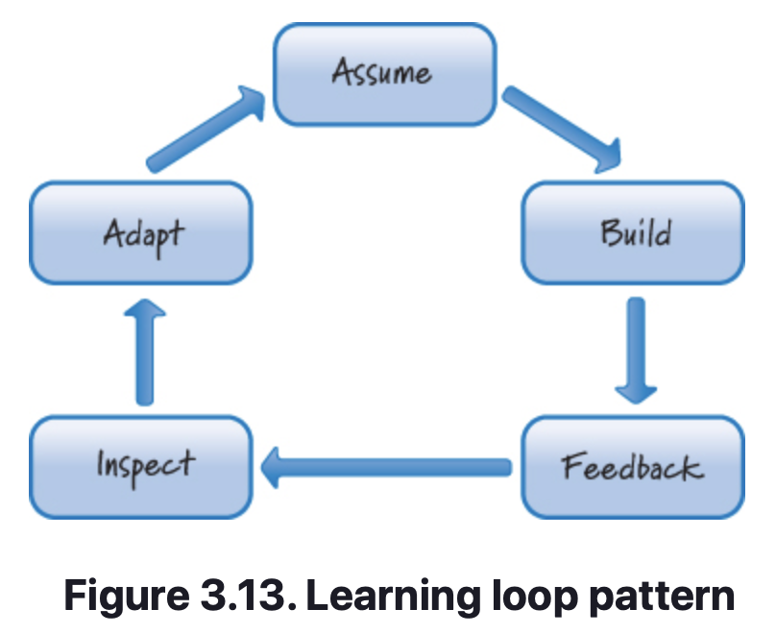
Agile Principles
Leverage Multiple Concurrent Learning Loops
There is learning that occurs when using sequential development.
However, an important form of learning happens only after features have been built, integrated, and tested, which means considerable learning occurs toward the end of the effort.
When using Scrum, we identify and exploit feedback loops to increase learning. A recurring pattern in this style of product development is to make an assumption (or set a goal), build something (perform some activities), get feedback on what we built, and then use that feedback to inspect what we did relative to what we assumed.
We then make adaptations to the product, process, and/or our beliefs based on what we learned (see Figure 3.13).
Notes:
Scrum leverages several predefined learning loops. For example, the daily scrum is a daily loop and the sprint review is an iteration-level loop. I will describe these and others in subsequent chapters.
The Scrum framework is also flexible enough to embrace many other learning loops. For example, although not specified by Scrum, technical practice feedback loops, such as pair programming (feedback in seconds) and test-driven development (feedback in minutes), are frequently used with Scrum development.

Slide 47
Agile Principles
Organize Workflow for Fast Feedback
In a plan-driven development effort, every activity is planned to occur at an appointed time based on the well-defined phase sequence. This approach assumes that earlier activities can be completed without the feedback generated by later activities.
As a result, there might be a long period of time between doing something and getting feedback on what we did (hence closing the learning loop).
Using component integration and testing as an example. Say we are developing three components in parallel. At some time these components have to be integrated and tested before we have a shippable product. Until we try to do the integration, we really don’t know whether we have developed the components correctly. Attempting the integration will provide critical feedback on the component development work.

Slide 48
Agile Principles
Organize Workflow for Fast Feedback
Feedback-generating activities that occur a long time after development have unfortunate side effects, such as turning integration into a large test-and-fix phase, because components developed disjointedly from each other frequently don’t integrate smoothly.
In Scrum, the flow of work is organized to move through the learning loop and get to feedback as quickly as possible. In doing so, we ensure that feedback-generating activities occur in close time proximity to the original work.
Fast feedback provides superior economic benefits because errors compound when we delay feedback, resulting in exponentially larger failures.

Slide 49
Agile Principles
Work In Process (WIP)
Work in process (or WIP) refers to the work that has been started but not yet finished. During product development WIP must be recognized and properly managed. I describe four agile principles related to this topic:
Use economically sensible batch sizes.
Recognize inventory and manage it for good flow.
Focus on idle work, not idle workers.
Consider cost of delay.

Slide 50
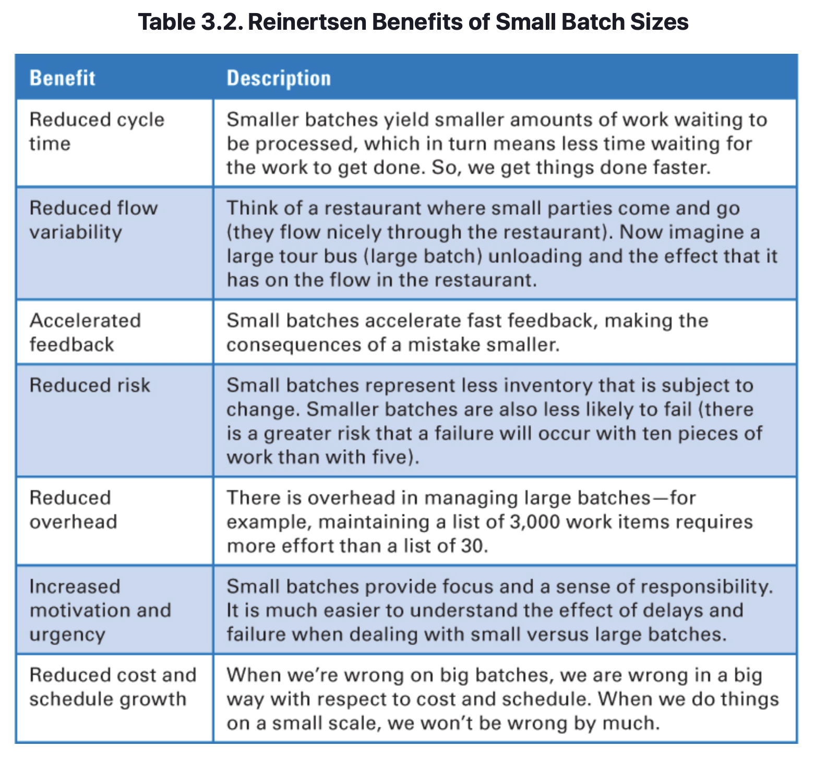
Agile Principles
Use Economically Sensible Batch Sizes
Notes:
If small batches are better than large batches, shouldn’t we just use a batch size of one, meaning that we work on only one requirement at a time and flow it through all of the activities until it is done and ready for a customer? Some people refer to this as single-piece flow. As I will show in later chapters, a batch size of one might be appropriate in some cases, but assuming that “one” is the goal might suboptimize the flow and our overall economics.

Slide 51
Agile Principles
Recognize Inventory and Manage It for Good Flow
Manufacturing and product development are not the same thing and thus should be approached differently.
There is, however, one lesson that manufacturing has learned that we should apply to product development and yet often do not. That lesson has to do with the high cost of inventory, also known as work in process or WIP.
It’s obvious that if we sit on a lot of inventory and then something changes, we experience one or more forms of significant waste.
Part of the problem with software stems from the fact that in product development we deal with knowledge assets that aren’t physically visible in the same way as parts on the factory floor. Knowledge assets are far less intrusive, such as code on a disk, a document in a file cabinet, or a visual board on the wall.
In Scrum, our goal is to find the proper balance between just enough inventory and too much inventory.

Slide 52
Agile Principles
Focus on Idle Work, Not Idle Workers
In Scrum, we believe that idle work is far more wasteful and economically damaging than idle workers. Idle work is work that we want to do (such as building or testing something) but can’t do because something is preventing us.
Perhaps we are blocked waiting on another team to do something, and until that team completes its work, we can’t do ours.
Or maybe we just have so much work to do that it can’t all be done at once. In this case, some of the work sits idle until we become available to work on it.
Idle workers, on the other hand, are people who have available capacity to do more work because they are not currently 100% utilized.

Slide 53
Agile Principles
Focus on Idle Work, Not Idle Workers
Many product development organizations focus more on eliminating the waste of idle workers than on the waste of idle work. For example, in traditional thinking, if I hire you to be a tester, I expect you to spend 100% of your time testing. To avoid this problem, I will find you more testing work to do—perhaps by assigning you to multiple projects—to get your utilization up to 100%.
Unfortunately, this approach reduces one form of waste (idle-worker waste) while simultaneously increasing another form of waste (idle-work waste). And, most of the time, the cost of the idle work is far greater than the cost of an idle worker. Let’s explore why this is true.

Slide 54
Agile Principles
Focus on Idle Work, Not Idle Workers
To illustrate the issue, let’s apply the keep-workers-100%-busy strategy to the 4 × 100-meter relay race at the Olympics. Based on the keep-them-busy strategy, this race seems highly inefficient. I pay people to run and they seem to be running only one-quarter of the time. The rest of the time they are just standing around.
Well, that’s not right! I pay them 100% salary so I want them to run 100% of the time. How about if when they’re not carrying the baton, they just run up and down the stands or perhaps run another race on an adjacent track? That way they will be utilized 100% at running.
Of course, we all know that you don’t win the relay gold medal by keeping the runners 100% busy. You win the gold medal by getting the baton across the finish line first.
So, the important takeaway is “Watch the baton, not the runners” (Larman and Vodde 2009).
Notes:
Anyone who owns a computer understands this graph. What happens if you run your computer at 100% (full processor and memory utilization)? It starts to thrash and every job on the computer slows down. In other words, the computer is working on more things and actually gets less productive work completed. Once you get into that state, it is very difficult to get out of it (you probably have to start killing jobs or reboot the machine). Your computer would be much more efficient if you ran it at closer to 80% utilization. In Figure 3.15, queue size equates to delay and delay to the baton sitting on the ground.
The idle work (delayed work) grows exponentially once we get into the high levels of utilization. And that idle work can be very expensive, frequently many times more expensive than the cost of idle workers (see the next section on cost of delay for an example). So, in Scrum, we are acutely aware that finding the bottlenecks in the flow of work and focusing our efforts on eliminating them is a far more economically sensible activity than trying to keep everyone 100% busy.

Slide 55
Agile Principles
Consider Cost of Delay
Cost of delay is the financial cost associated with delaying work or delaying achievement of a milestone.
By reducing the waste of idle workers (e.g. increasing their utilization), we simultaneously increase the waste associated with idle work (work sitting in queues waiting to be serviced). Using cost of delay, we can calculate which waste is more economically damaging.
Unfortunately, 85% of organizations don’t quantify cost of delay (Reinertsen 2009b). Combine that with the fact that most development organizations don’t realize they have accumulated work (inventory) sitting in queues, and it is easy to see why their default behavior is to focus on eliminating the visible waste of idle workers.

Slide 56
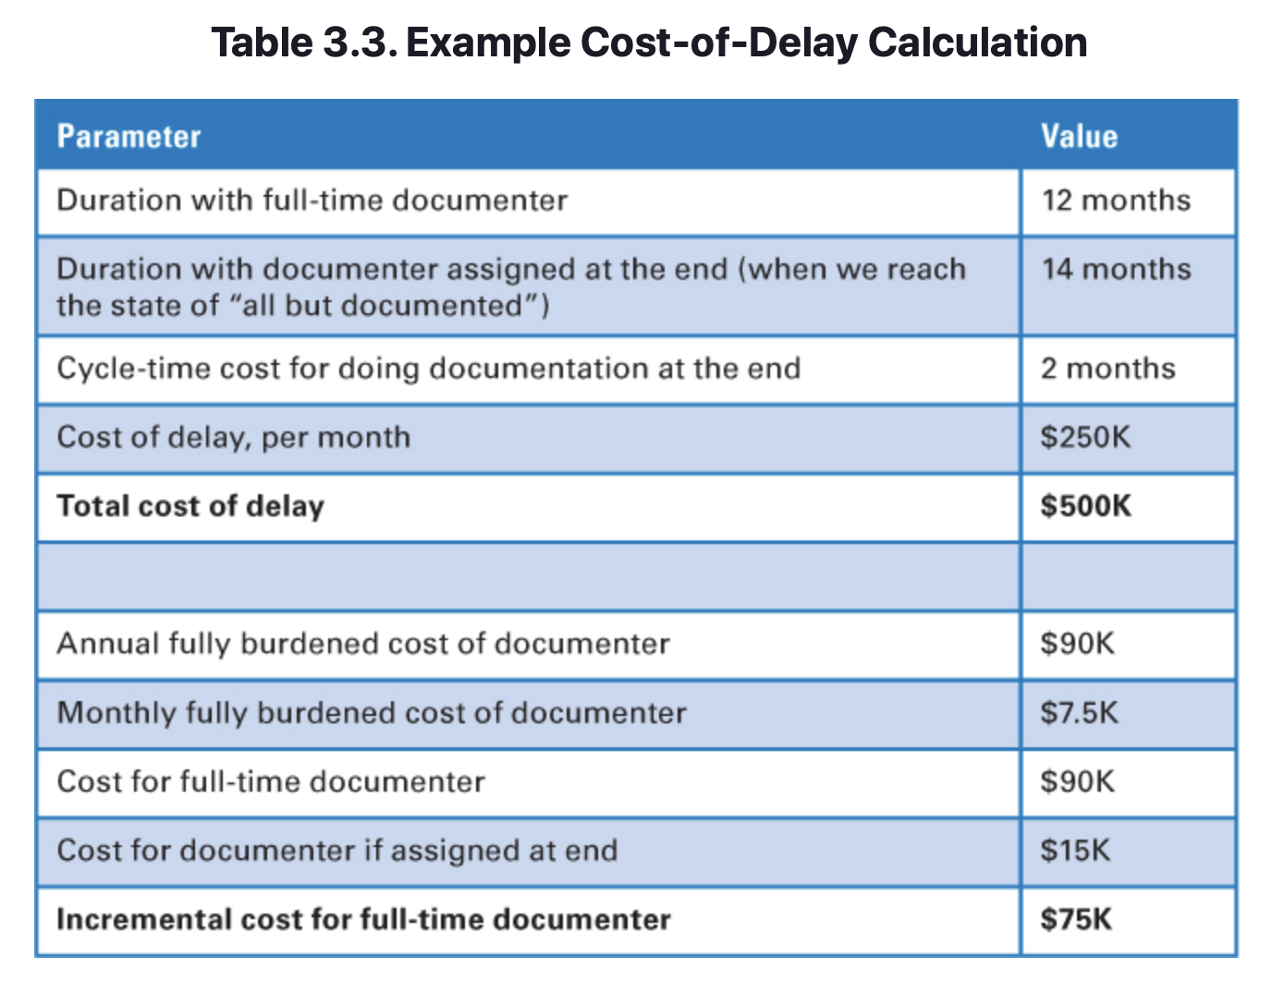
Agile Principles
Consider Cost of Delay
Consider this question: Should we assign a documenter to the team on the first day of development or at the end of development? Table 3.3 illustrates a comparison of these two options.
Assume that we assign the documenter full-time for 12 months to work on this product, even if he is not needed 100% of the time. Doing so costs an incremental $75K above what it would cost if we brought him on for two months at the end once the product reaches the state of “all but documented.”
If we assign the documenter to do all of the documentation at the end, we will need him full-time for only two months, but we will also delay the delivery of the product by the same two months.
If we delay shipping the product by two months, the calculated cost of delay in terms of lifecycle profits is $500K.
Notes:
In this example, the cost of the idle worker is $75K and the cost of the idle work is $500K. If we focus on optimizing the utilization of the documenter, we will substantially suboptimize the economics of the overall product. During product development we are presented with these types of trade-offs on a continuous basis; cost of delay will be one of the most important variables to consider when making economically sensible decisions.

Slide 57
Agile Principles
Progress
When using Scrum, we measure progress by what we have delivered and validated, not by how we are proceeding according to a predefined plan or how far we are into a particular phase or stage of development. We will discuss three agile principles related to this topic:
Adapt to real-time information and replan.
Measure progress by validating working assets.
Focus on value-centric delivery.

Slide 58
Agile Principles
Adapt to Real-Time Information and Replan
In a plan-driven, sequential process, the plan is the authoritative source on how and when work should occur.
As such, conformance to the plan is expected. In contrast, in Scrum we believe that unbridled faith in the plan will frequently blind us to the fact that the plan might be wrong.
On a Scrum development effort our goal is not to conform to some plan, some up-front prediction of how we thought things might go.
Instead, our goal is to rapidly replan and adapt to the stream of economically important information that is continuously arriving during the development effort.

Slide 59
Agile Principles
Measure Progress by Validating Working Assets
Progress during a sequential, plan-driven development effort is demonstrated by completing a phase and being permitted to enter the next phase.
As a result, if each phase starts and completes as expected, the product development effort might seem to be progressing quite well.
Yet in the end, the product we created in full accordance with the plan might deliver far less customer value than anticipated.
Can we really claim success if we finish on time and on budget and yet fail to meet customer expectations?
Scrum measures progress by deliver working, validated assets that bring value and that can be used to validate important assumptions. This gives us the feedback to know what the right next step is. In Scrum, it’s not about how much work we start; it’s all about what customer-valuable work we finish.

Slide 60
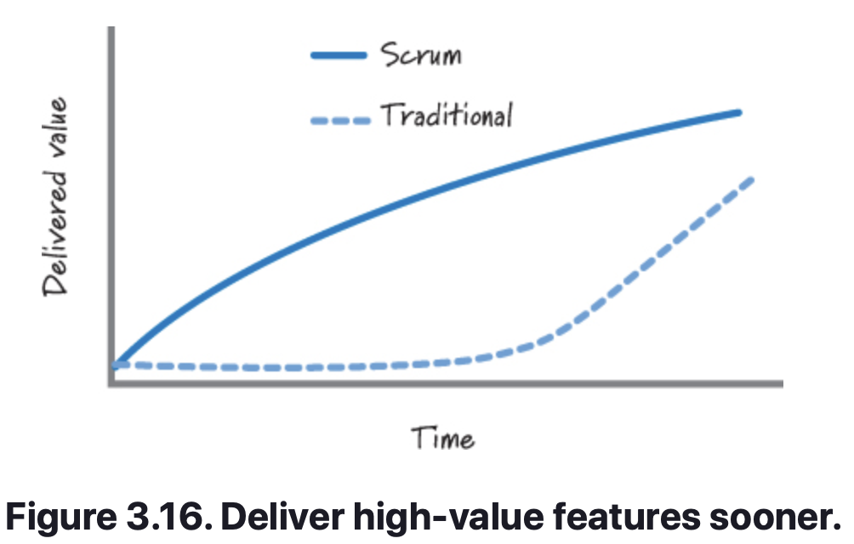
Agile Principles
Focus on Value-Centric Delivery
Plan-driven, sequential development focuses on diligently following the process. By its very structure, the integration and delivery of features during sequential development happen at the end of the effort (see Figure 3.16). With this approach there is a risk that we will run out of resources (time or money) before we deliver all of the important value to our customers.
A related belief of traditional development is that the planning and document artifacts that get produced en route to delivering features are themselves valuable. If these artifacts are indeed valuable, most of the time they are valuable only to the downstream process and not the customers. And, if they are valuable to the customer, that value accrues only if a desirable product is ultimately delivered to the customer.
Notes:
Scrum, on the other hand, is a customer-value-centric form of development. It is based on a prioritized, incremental model of delivery in which the highest-value features are continuously built and delivered in the next iteration. As a result, customers get a continuous flow of high-value features sooner.
In Scrum, value is generated by delivering working assets to customers, by validating important assumptions, or by acquiring valuable knowledge. In Scrum, we believe that the intermediate artifacts provide no perceived customer value and are merely a means to an end if they themselves cannot be used to generate important feedback or acquire important knowledge.

Slide 61
Agile Principles
Go Fast but Never Hurry
Plan-driven development believes that if we follow the plan and do things right the first time, we’ll avoid costly and time-consuming rework.
In Scrum, one core goal is to be nimble, adaptable, and speedy. By delivering and obtaining feedback fast, we get value into the hands of our customers sooner. Learning and reacting quickly allow us to generate revenue and/or reduce costs sooner.
Fast is not the same as being hurried.
In Scrum, time is of the essence, but we don’t rush to get things done. Doing so would likely violate the Scrum principle of sustainable pace—people should be able to work at a pace that they can continue for an extended period of time.
Hurrying will likely come at the expense of quality.
Notes:
An example might help clarify the difference between fast and hurried. I study Muay Thai (Thai kickboxing). As is true of most martial arts, Muay Thai performance is enhanced with speed. Being able to swiftly and accurately perform katas or sparring enhances the pleasure of the sport and the outcome. However, hurrying through the movements with the intent of getting done substantially reduces their effectiveness and could cause serious bodily harm during sparring. When performing Muay Thai, you move swiftly, nimbly, and deliberately while quickly adapting to the situation. In other words, you need to be fast, but never hurried.

Slide 62
Agile Principles
Build in Quality
During plan-driven development, integrated system/product testing is the indicator to determine whether quality is lacking and this usually doesn’t occur until late in the development cycle.
When issues are found, the team then must enter a costly test-and-fix phase in an attempt to test quality in.
In Scrum, quality isn’t something a testing team “tests in” at the end; it is something that a cross-functional Scrum team owns and continuously builds in and verifies every sprint.
Each increment of value that is created is completed to a high level of confidence and has the potential to be put into production or shipped to customers.
As a result, the need for any significant late testing to tack on quality is substantially reduced.

Slide 63
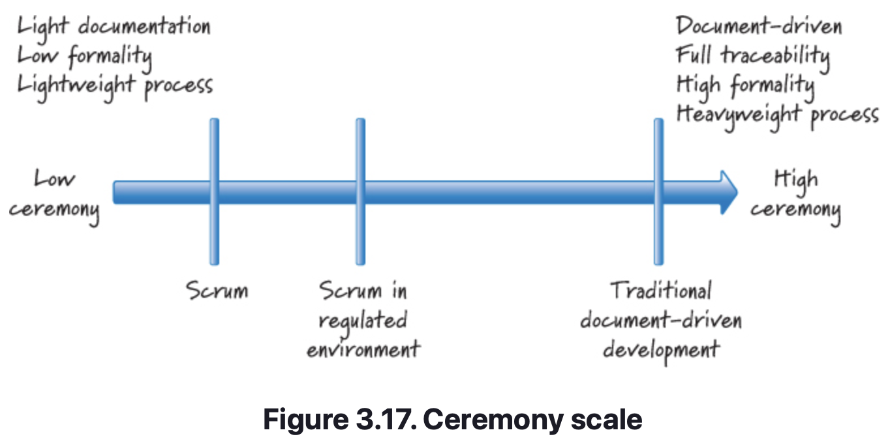
Agile Principles
Employ Minimally Sufficient Ceremony
Plan-driven processes tend to be high-ceremony, document-centric, process-heavy approaches.
Ceremony is ritualistic or symbolic activity that is performed on well-defined occasions.
A side effect of Scrum’s being value-centric is that very little emphasis is put on process-centric ceremonies and not all ceremony is bad.
Some might call it “process for the sake of process.” Such ceremony has a cost but adds little or no value.
Scrum isn’t anti-documentation. Rather, when using Scrum, we adopt an economic perspective and carefully review which documents we create and focus on those which add value.
Notes:
Example ceremonies that might be unnecessary formality include the following:
• A three-day, heavyweight process is required for approving and migrating code from the development environment to the QA environment before we are allowed to start testing.
• All anomalies have to be logged into a software tool so that they can be tracked and reported, even if I could just tap on the shoulder of the person sitting next to me and say, “Hey, this isn’t working; could you fix it?” and have him make a fix so I can continue my work.
• I write a document because now is the prescribed time to write that document, even though nobody can say why that document is necessary or valuable.
If we write a document that is shelfware and adds no value, we have wasted our time and money creating a dead document. However, not all documents are dead. For example, we will likely write a document if
• It is a deliverable as part of the product (for example, installation instructions, user’s guide, and so on)
• Our goal is to capture an important discussion, decision, or agreement so that in the future we will have a clear recollection of what was discussed, decided, or agreed to
• It is the high-value way of helping new team members come up to speed quickly
• There is a regulatory requirement that a certain document be written (a cost of doing business in a regulated industry)
What we are trying to avoid is work that adds no short-term or long-term economic value. In Scrum, we believe that time and money are better spent delivering customer value.

Slide 64
Agile Principles
Closing
In this chapter we focused on describing core agile principles—the fundamental beliefs that drive how we develop with Scrum.
In doing so, we compared how these beliefs are different from the beliefs that underlie textbook, traditional, plan-driven, sequential development.
The goal of making this comparison is not to convince people that waterfall is bad and that Scrum is good. Instead, the goal is to illustrate that the underlying beliefs of waterfall make it more appropriate to a different class of problem than Scrum.
Each organization will evaluate the type of problems/challenges that they face and decide which is the more appropriate tool to use.

Slide 65
sprints
Chapter 4

Slide 66
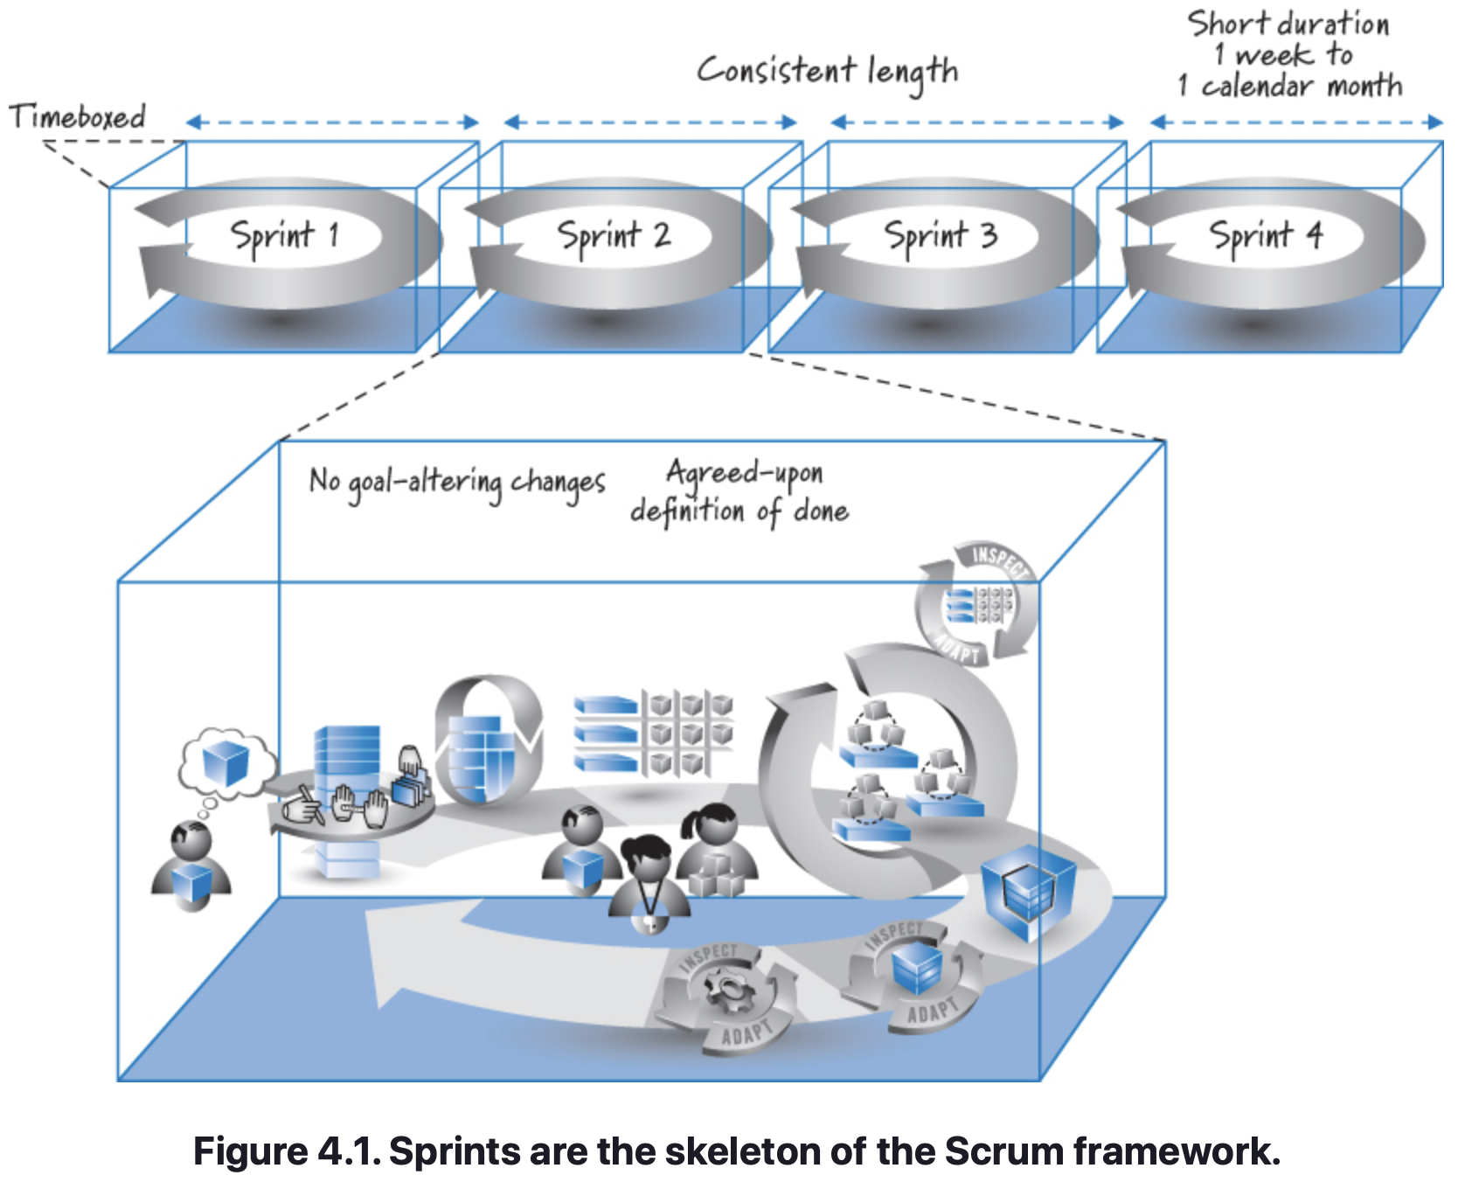
Sprints
Overview
Scrum organizes work in iterations or cycles of up to a calendar month called sprints. This chapter provides a more detailed description of a sprint, as well as several key characteristics of sprints: They are timeboxed, have a short and consistent duration (e.g. constraint), have a goal that shouldn’t be altered once started, and must reach the end state specified by the team’s definition of “done”.
Notes:
All sprints are timeboxed, meaning they have fixed start and end dates. Sprints must also be short, somewhere between one week and a calendar month in length. Sprints should be consistent in length, though exceptions are permitted under certain circumstances. As a rule, no goal-altering changes in scope or personnel are permitted during a sprint. Finally, during each sprint, a potentially shippable product increment is completed in conformance with the Scrum team’s agreed-upon definition of done.
Although each organization will have its own unique implementation of Scrum, these sprint characteristics, with a few exceptions that we’ll explore, are meant to apply to every sprint and every team. Let’s look at each in detail so that we can understand why this is so.

Slide 67
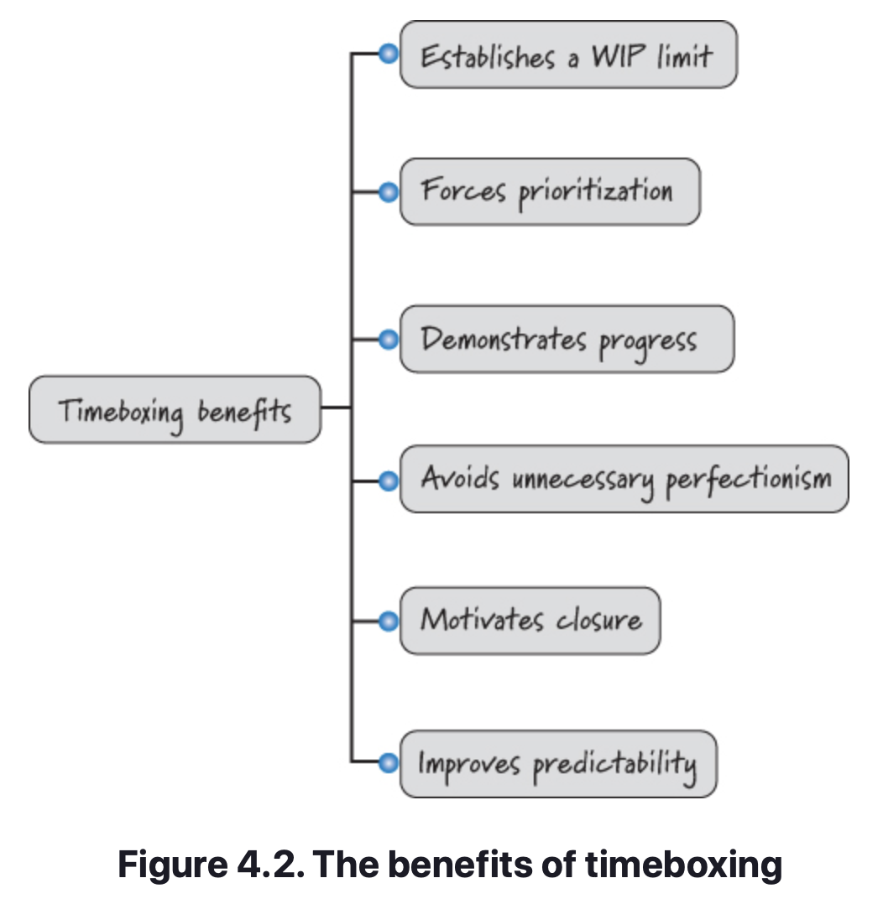
Sprints
Timeboxed
Sprints are rooted in the concept of timeboxing, a time-management technique that helps organize the performance of work and manage scope.
Each sprint takes place in a time frame with specific start and end dates, called a timebox. Inside this timebox, the team is expected to work at a sustainable pace to complete a chosen set of work that aligns with a sprint goal.
Timeboxing is important for several reasons (see Figure 4.2).

Slide 68
Sprints
Benefits of Timeboxing
Establishes a WIP Limit
Timeboxing is a technique for limiting the amount of WIP (work in process). WIP represents an inventory of work that is started but not yet finished. Failing to properly manage it can have serious economic consequences. Because the team will plan to work on only those items that it believes it can start and finish within the sprint, timeboxing establishes a WIP limit each sprint.
Forces Prioritization
Timeboxing forces us to prioritize and perform the small amount of work that matters most. This sharpens our focus on getting something valuable done quickly.

Slide 69
Sprints
Benefits of Timeboxing
Demonstrates Progress
Timeboxing also helps us demonstrate relevant progress by completing and validating important pieces of work by a known date (the end of the sprint). Timeboxing also helps us demonstrate progress against big features that require more than one timebox to complete. Completing some work toward those features ensures that valuable, measurable progress is being made each sprint. It also helps the stakeholders and team learn exactly what remains to be done to deliver the entire feature.
Avoids Unnecessary Perfectionism
At one time or another we have all spent too much time trying to get something perfect when good enough would suffice. Timeboxing forces an end to potentially unbounded work by establishing a fixed end date for the sprint by which a good solution must be done.

Slide 70
Sprints
Benefits of Timeboxing
Motivates Closure
Timeboxing motivates closure. Experience has shown that things are more likely to get done when teams have a known end date. The fact that the end of the sprint brings with it a hard deadline encourages team members to diligently apply themselves to complete the work on time. Without a known end date, there is less of a sense of urgency to complete the job.
Improves Predictability
Timeboxing improves predictability. Although we can’t predict with great certainty exactly the work we will complete a year from now, it is completely reasonable to expect that we can predict the work we can complete in the next short sprint.

Slide 71
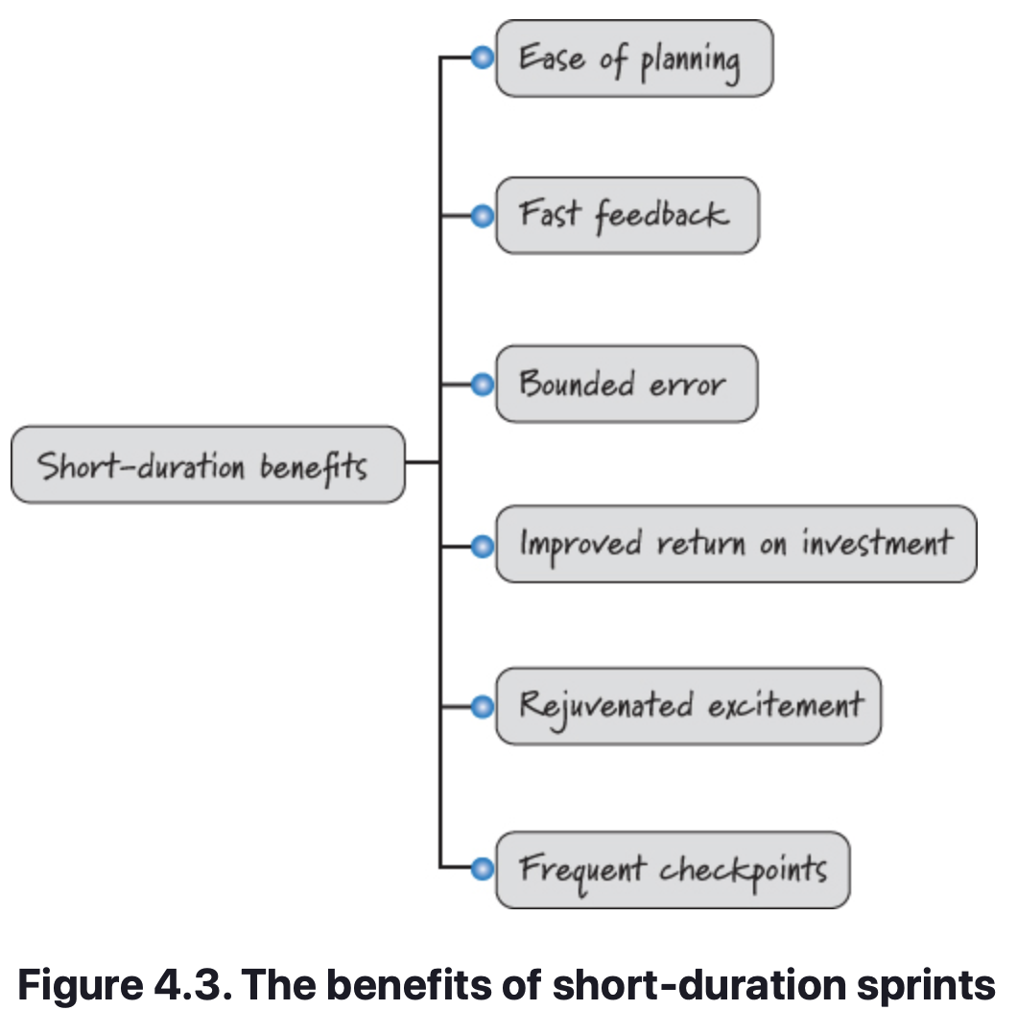
Sprints
Short Duration Sprints
Short-duration sprints provide many benefits (see Figure 4.3).

Slide 72
Sprints
Benefits of Short Duration Sprints
Ease of Planning
Short-duration sprints make it easier to plan. It is easier to plan a few weeks’ worth of work than six months’ worth of work. Also, planning on such short time horizons requires far less effort and is far more accurate than longer-horizon planning.
Fast Feedback
Short-duration sprints generate fast feedback. During each sprint we create working software and then have the opportunity to inspect and adapt what we built and how we built it. This fast feedback enables us to quickly prune unfavorable product paths or development approaches before we compound a bad decision with many follow-on decisions that are coupled to the bad decision. Fast feedback also allows us to more quickly uncover and exploit time-sensitive emergent opportunities.

Slide 73
Sprints
Benefits of Short Duration Sprints
Improved Return on Investment
Short-duration sprints not only improve the economics via fast feedback; they also allow for early and more frequent deliverables. As a result, we have the opportunity to generate revenue sooner, improving the overall return on investment.
Bounded Error
Short-duration sprints also bound error. How wrong can we be in a two-week sprint? Even if we fumble the whole thing, we have lost only two weeks. We insist on short-duration sprints because they provide frequent coordination and feedback.

Slide 74
Sprints
Benefits of Short Duration Sprints
Rejuvenated Excitement
Short-duration sprints can help rejuvenate excitement. It is human nature for interest and excitement to decline the longer we have to wait for gratification.
If we work on a very long-duration project, not only are we more likely to fail; we are also more likely to eventually lose enthusiasm for the effort. With no visible progress and no end in sight, people begin to grow disinterested.
Keeps participant excitement high by delivering working assets frequently. The gratification from early and frequent deliverables rejuvenates our interest and our desire to continue working toward the goal.

Slide 75
Sprints
Benefits of Short Duration Sprints
Frequent Checkpoints
Scrum provides managers, stakeholders, product owners, and others with many more checkpoints than they would have with sequential projects.
At the end of each short sprint there is a meaningful checkpoint (the sprint review) that allows everyone to base decisions on demonstrable, working features.
People are better able to deal with a complex environment when they have more actionable checkpoint opportunities to inspect and adapt.

Slide 76
Sprints
Consistent Duration
As a rule, on a given development effort, a team should pick a consistent duration for its sprints and not change it unless there is a compelling reason. Compelling reasons might include the following:
You are considering moving from four-week sprints to two-week sprints in order to obtain more frequent feedback but want to try a couple of two-week sprints before making a final decision.
The annual holiday season or end of the fiscal year make it more practical to run a three-week sprint than the usual two-week sprint.
The product release occurs in one week, so a two-week sprint would be wasteful.

Slide 77
Sprints
Consistent Duration
The fact that the team cannot get all the work done within the current sprint length is not a compelling reason to extend the sprint length. Neither is it permissible to get to the last day of the sprint, realize you are not going to be done, and lobby for an extra day or week.
As a rule, therefore, if a team agrees to perform two-week sprints, all sprints should be two weeks in duration. As a practical matter, most (but not all) teams will define two weeks to mean ten calendar weekdays. If there is a one-day holiday or training event during the sprint, it reduces the team’s capacity for that sprint but doesn’t necessitate a sprint length change.
Using the same sprint length also leverages the benefits of cadence and simplifies planning.
Notes:
Cadence Benefits
Sprints of the same duration provide us with cadence—a regular, predictable rhythm or heartbeat to a Scrum development effort. A steady, healthy heartbeat allows the Scrum team and the organization to acquire an important rhythmic familiarity with when things need to happen to achieve the fast, flexible flow of business value. In my experience, having a regular cadence to sprints enables people to “get into the zone,” “be on a roll,” or “get into a groove.” I believe this happens because regular cadence makes the mundane but necessary activities habitual, thereby freeing up mental capacity to stay focused on the fun, value-added work.
Simplifies Planning
Using a consistent duration also simplifies planning activities. When all sprints are the same length (even when they might have a day or less capacity per sprint because of a holiday), the team gets comfortable with the amount of work that it can accomplish in a typical sprint (referred to as its velocity). Velocity is typically normalized to a sprint. If the length of the sprint can vary, we really don’t have a normalized sprint unit. It wouldn’t be meaningful to say things like “The team has an average velocity of 20 points per sprint.”
While it is certainly possible to compute a team’s velocity even if it uses variable-length sprints, it is more complicated. Sticking with a consistent sprint duration simplifies the computations we perform on a team’s historical velocity data.

Slide 78
Sprints
No Goal-Altering Changes
An important Scrum rule states that once the sprint goal has been established and sprint execution has begun, no change is permitted that can materially affect the sprint goal.
Each sprint can be summarized by a sprint goal that describes the business purpose and value of the sprint. Typically the sprint goal has a clear, single focus, such as:
Support initial report generation.
Load and curate North America map data.
Demonstrate the ability to send a text message through an integrated software, firmware, and hardware stack.
There are times when a sprint goal might be multifaceted, for example, “Get basic printing working and support search by date.”

Slide 79
Sprints
No Goal-Altering Changes
Mutual Commitment
The sprint goal is the foundation of a mutual commitment made by the team and the product owner. The team commits to meeting the goal by the end of the sprint, and the product owner commits to not altering the goal during the sprint.
Change versus Clarification
Although the sprint goal should not be materially changed, it is permissible to clarify the goal.
A change is any alteration in work or resources that has the potential to generate economically meaningful waste, harmfully disrupt the flow of work, or substantially increase the scope of work within a sprint.
Clarifications are additional details provided during the sprint that assist the team in achieving its sprint goal.
Notes:
The following example illustrates a change:
Product owner: “Oh, when I said that we need to be able to search the police database for a juvenile offender, I didn’t just mean by last name and first name. I also meant we should be able to search the database based on a picture of the suspect’s body tattoos!”
The following example illustrates a clarification:
Development team: “When you said the matches for a juvenile offender search should be displayed in a list, did you have a preference for how that list is to be ordered?”
Product owner: “Yes, sort them alphabetically by last name.”
Development team: “OK, we can do that.”

Slide 80
Sprints
No Goal-Altering Changes
Consequences of Change
It may appear that the no-goal-altering-change rule is in direct conflict with the core Scrum principle that we should embrace change. We do embrace change, but we want to embrace it in a balanced, economically sensible way.
The economic consequences of a change increase as our level of investment (or progress) in the changed work increases.
In addition, once we begin sprint execution, our investment in work increases even more as product backlog items transition through the states of to do (work not yet started), doing (work in process), and done (work completed).
When the product owner makes a commitment to not alter the goal and then violates the commitment, the team naturally will be demotivated, which will almost certainly affect its desire to work diligently to complete other product backlog items.

Slide 81
Sprints
No Goal-Altering Changes
Being Pragmatic
The no-goal-altering-change rule is just that—a rule, not a law. The Scrum team has to be pragmatic.
What if business conditions change in such a way that making a change to the sprint goal seems warranted? Say a competitor launches its new product during our sprint. After reviewing the new product, we conclude that we need to alter the goal we established for our current sprint because what we are doing is now economically far less valuable given what our competitor has done. Should we blindly follow the rule of no goal-altering changes and not alter our sprint? Not likely.
As for team motivation and trust, when a product owner has a frank, economically focused discussion with the team about the necessity of the change, most teams understand and appreciate the need, so the integrity of motivation and trust is upheld.

Slide 82
Sprints
Definition of Done
The result of each sprint should be a potentially shippable product increment. “Potentially shippable” doesn’t mean that what was built must actually be shipped. Shipping is a business decision that often occurs at a different cadence; in some organizations it may not make sense to ship at the end of every sprint.
Potentially shippable is better thought of as a state of confidence that what got built in the sprint is actually done, meaning that there isn’t materially important undone work (such as important testing or integration and so on) that needs to be completed before we could ship the results from the sprint, if shipping was our business desire.
To determine if what got produced is potentially shippable, the Scrum team must have a well-defined, agreed-upon definition of done.

Slide 83
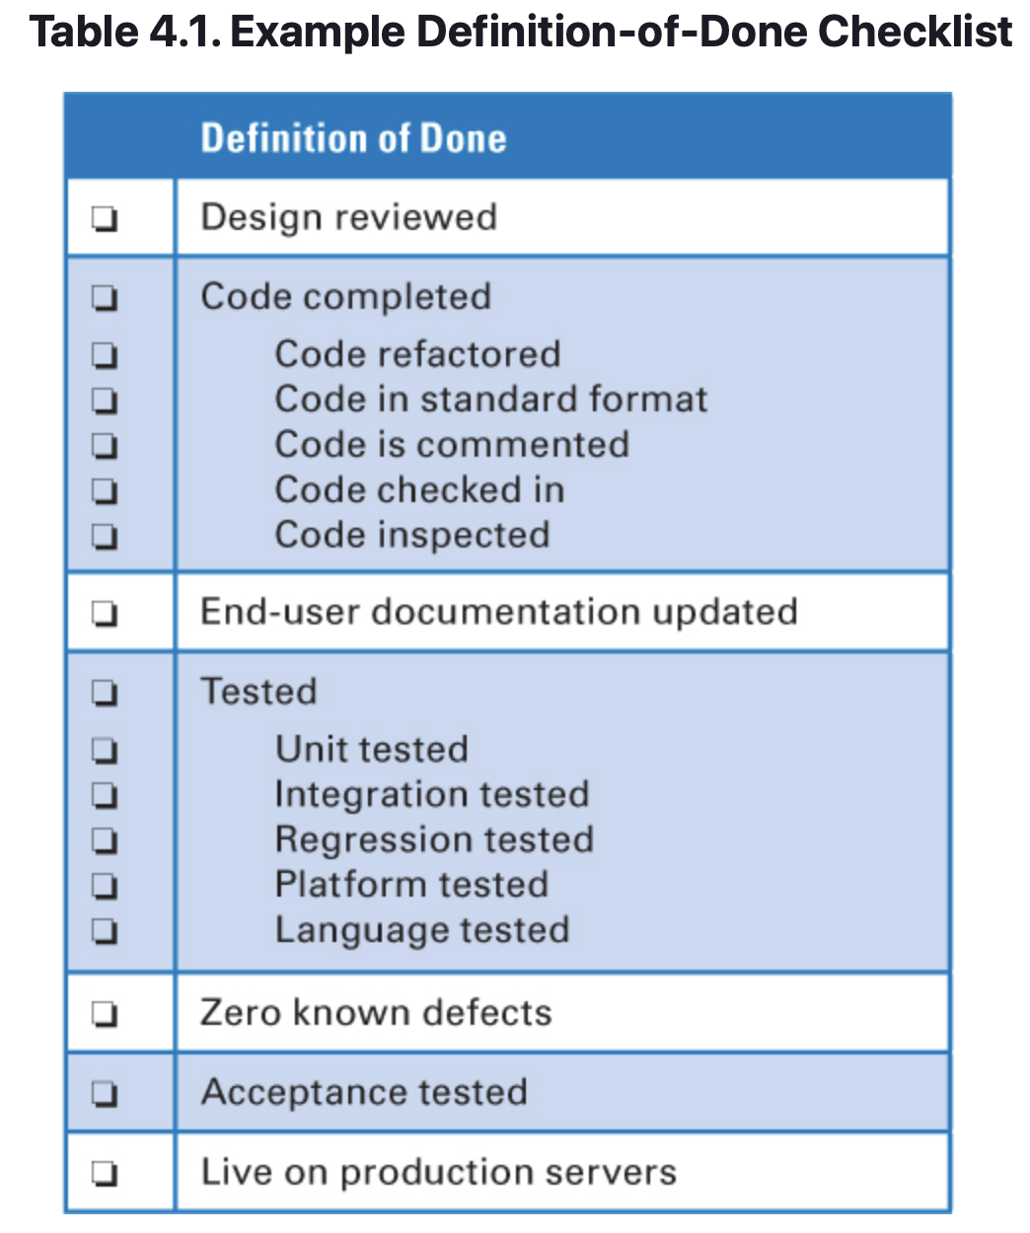
Sprints
Definition of Done
What Is the Definition of Done?
Conceptually the definition of done is a checklist of the types of work that the team is expected to successfully complete before it can declare its work to be potentially shippable (see Table 4.1).
Most of the time, a bare-minimum definition of done should yield a complete slice of product functionality, one that has been designed, built, integrated, tested, and documented and would deliver validated customer value. To have a useful checklist, however, these larger-level work items need to be further refined.
For example, what does tested mean? Unit tested? Integration tested? System tested? Platform tested? Internationalization tested?

Slide 84
Sprints
Definition of Done
What Is the Definition of Done?
From the Author: Often I am asked, “What if there is a significant defect that remains on the last day of the sprint; is the product backlog item done?” No, it’s not done! And because, as a rule, we don’t extend sprints beyond the end of the planned timebox, we wouldn’t extend the sprint by a day or two to fix the defect in the current sprint.
Instead, at the planned end of the sprint, the incomplete product backlog item is taken from the current sprint and reinserted into the product backlog in the proper order based on the other items that are currently in the product backlog. The incomplete item might then be finished in some future sprint.
Scrum teams need to have a robust definition of done, one that provides a high level of confidence that what they build is of high quality and can be shipped. Anything less robs the organization of the business opportunity of shipping at its discretion and can lead to the accrual of technical debt.

Slide 85
Sprints
Definition of Done
What Is the Definition of Done?
The definition of Done does not have to be static and can evolve over time.
Done is not the same as Acceptance Criteria.
Acceptance Criteria
Part of the being Done criteria.
May also be referred to as Conditions of Satisfaction.
Detailed attributes that accompany each item on the product backlog as part of the sprint.
Used to derive Acceptance Testing test cases.
Determined by the Product Owner.

Slide 86
Sprints
Closing
Emphasized the crucial role of sprints in the Scrum framework.
Sprints provide the essential Scrum skeleton on which most other activities and artifacts can be placed.
Sprints are short, timeboxed, and consistent in duration.
They are typically defined by a sprint goal, a goal that should not be altered without good economic cause.
Sprints should produce a potentially shippable product increment that is completed in conformance with an agreed-upon definition of done..

Slide 87
Sprints
Sources
Unless otherwise noted, all material in these slides were used from the textbook for this course:
Rubin, Kenneth S., Essential Scrum: A Practical Guide to the Most
Popular Agile Process, 1st Edition. Addison-Wesley Professional; 1st
edition (August 5, 2012). ISBN-13: 978-0137043293.

